Slide 1


Nitra living lab
Institutional capacity building
Róbert Blaško, living lab coordinator
This project has received funding from the
EU Horizon Europe Programme
3rd Webstival, 28 April 2026

Slide 2
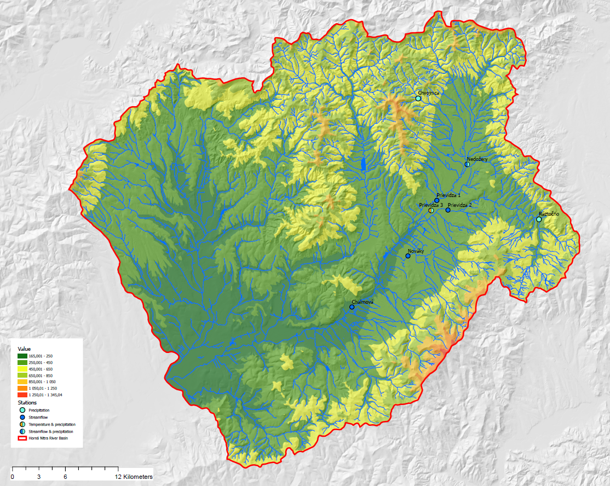
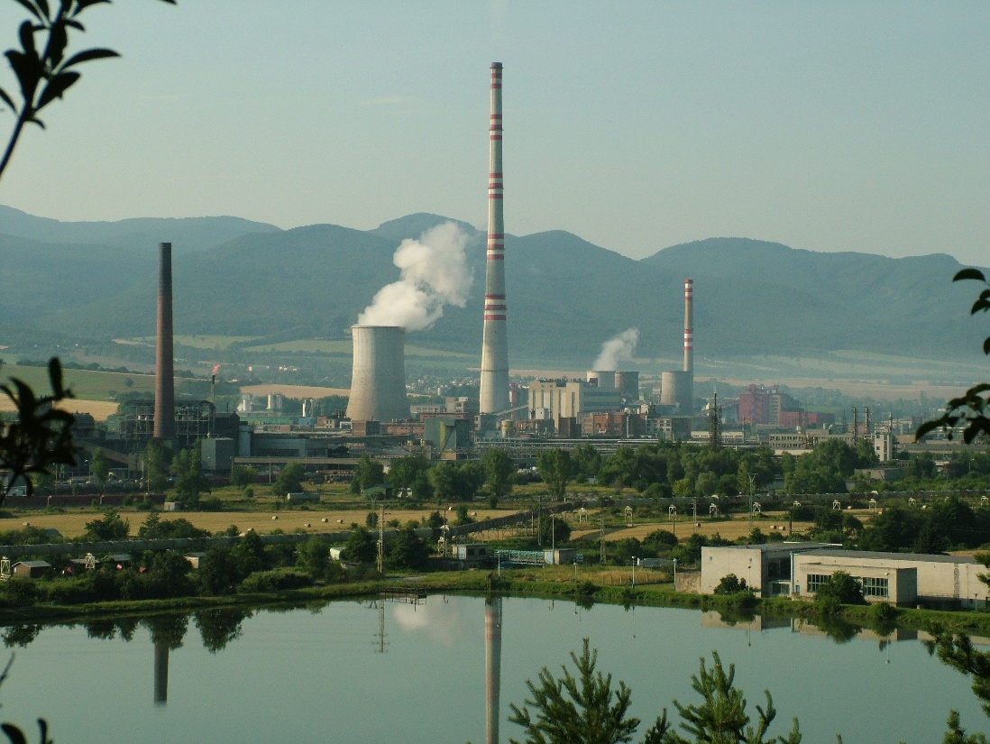
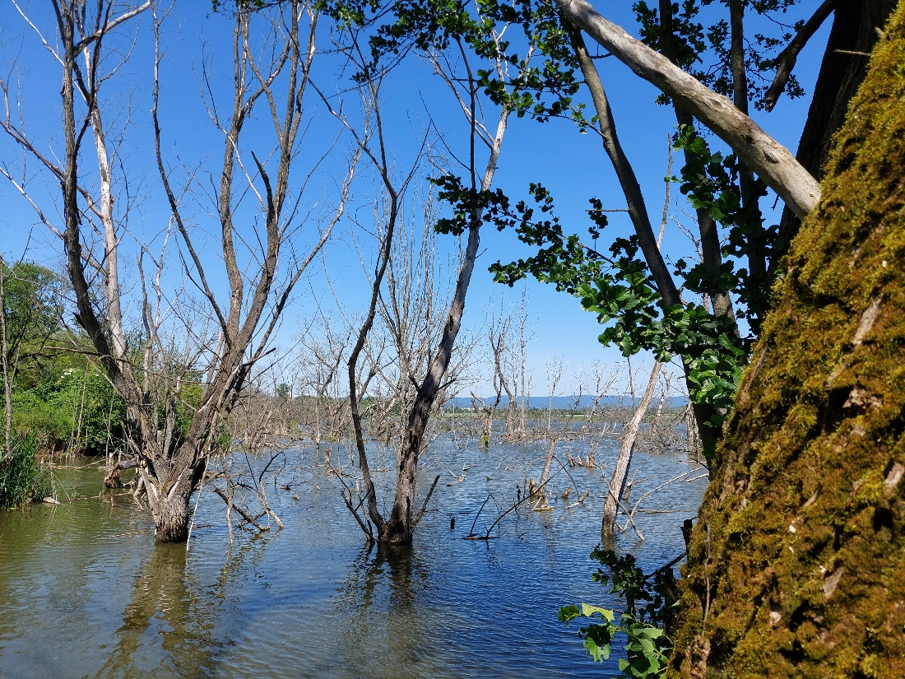
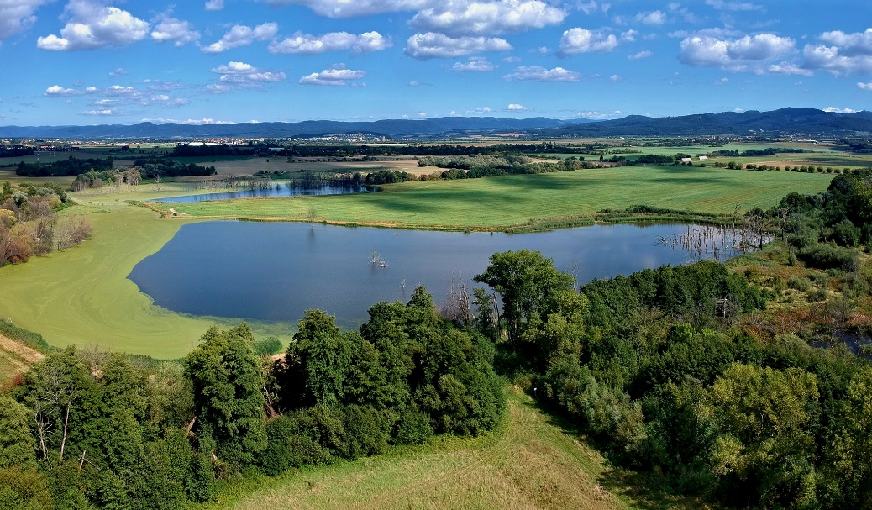
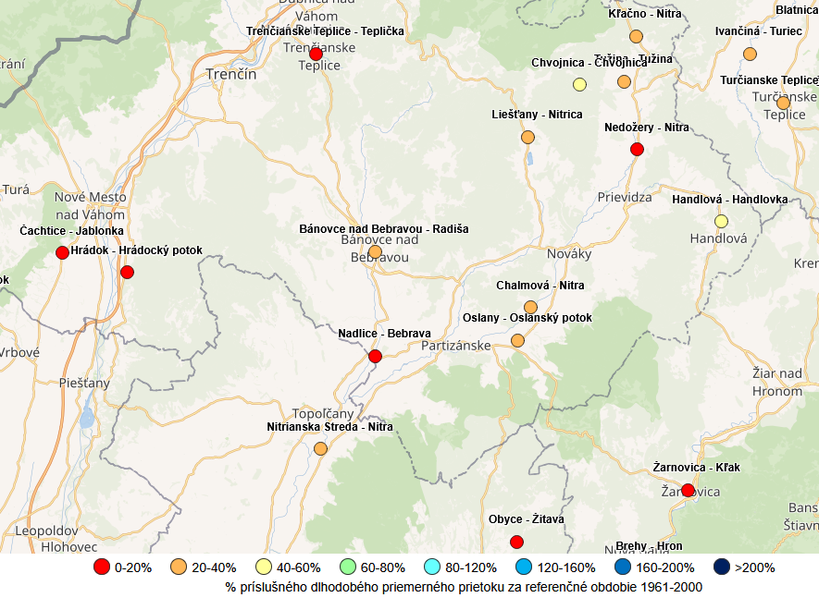
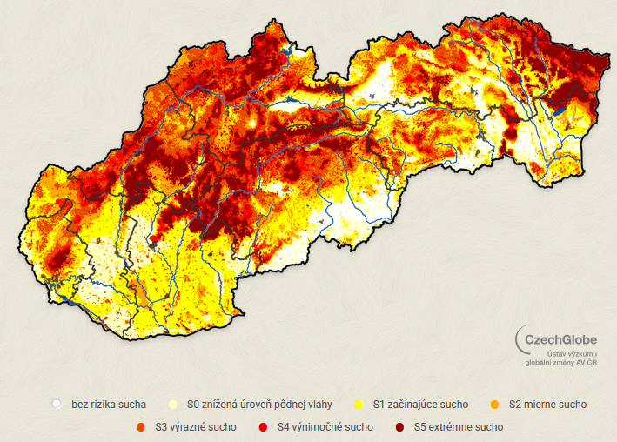
Nitra River Basin
Nitra living lab
Industrial and domestic water use
Region prone to droughts due to its geology and mining
Climate projections show reduced water supply by climate change
Shifts in hydrological cycle
SVP

Slide 3
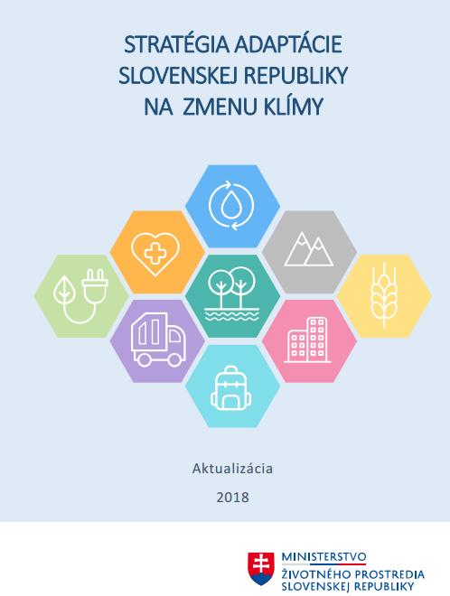
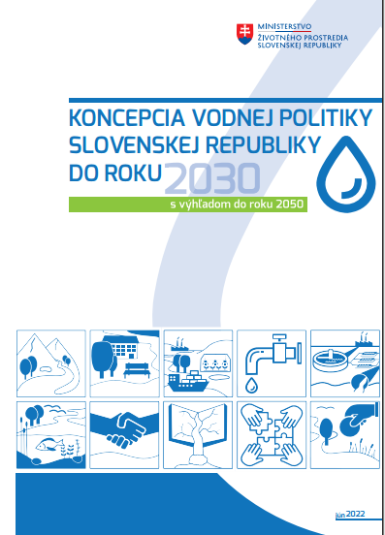
Institutional capacity
On national level anchored in the key strategic documents – NAS, NAP, Water Policy Concept 2030, Environmental Strategy 2030
SAŽP has a central role in adaptation – as an expert institution of the Ministry of Environment (MoE) feeds into many strategic processes
SAŽP lead preparation of methodologies for adaptation in sectors
Together with MoE coordintes development of national adaptation platform (klima-adapt.sk)
Centre for climate change adaptation (2025)
Institutions under pressure – cuts in employees
Shortage of qualified experts

Slide 4
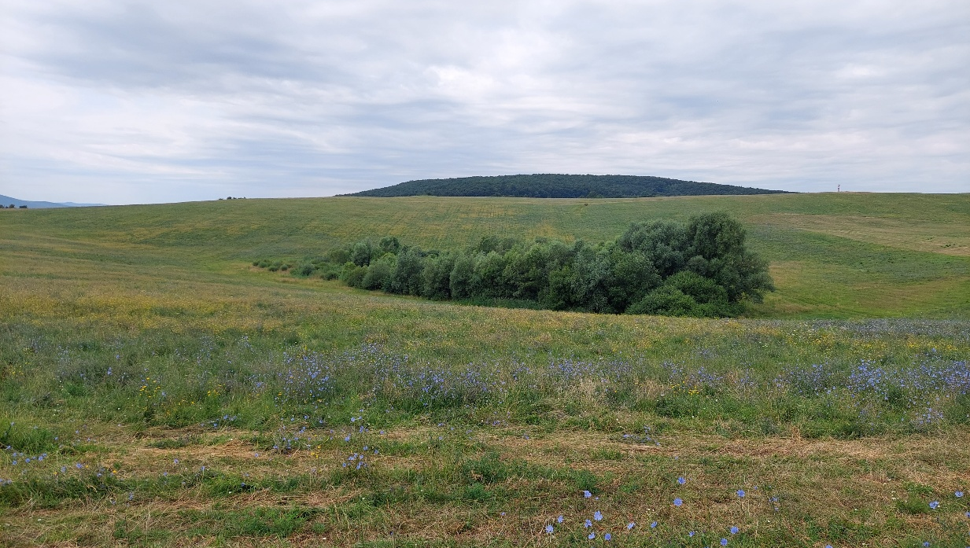
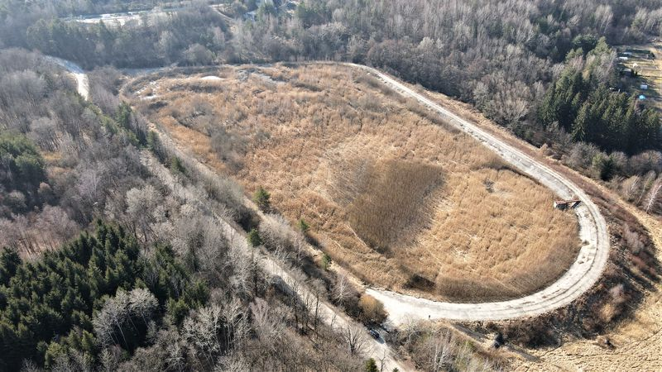
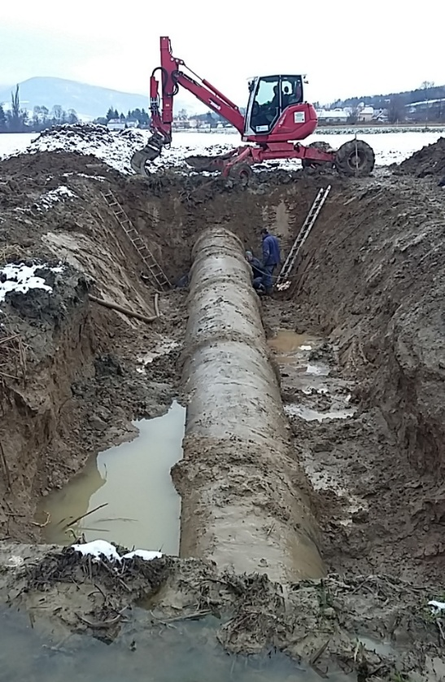
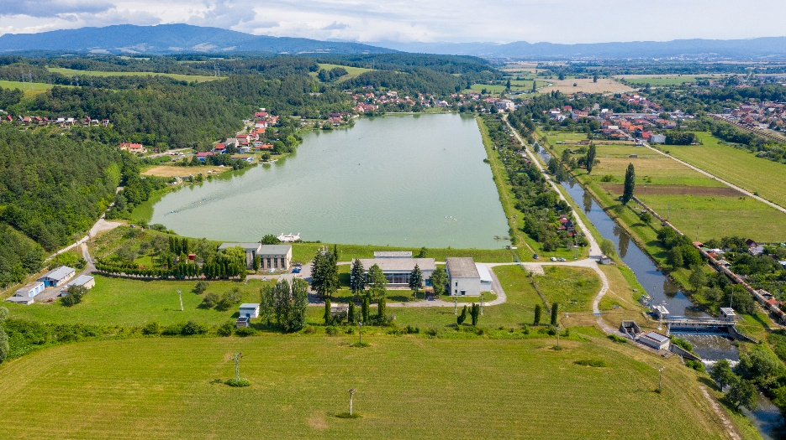
Nitra living lab
Institutions and entities lack capacities and resources for systemic adaptation
Mining company lost income after the mines closure due to phase out in 2023
Many processes such as EIA are time consuming and resource-demanding
Investment debt in water management sector
Modelling climate change impacts on water resources mostly done by academia
Data availability and accessibility
Water management is fragmented among many actors with different competencies
Adaptation is mostly fragmented and non-systemic
HBP, a.s.
SVP
SVP

Slide 5
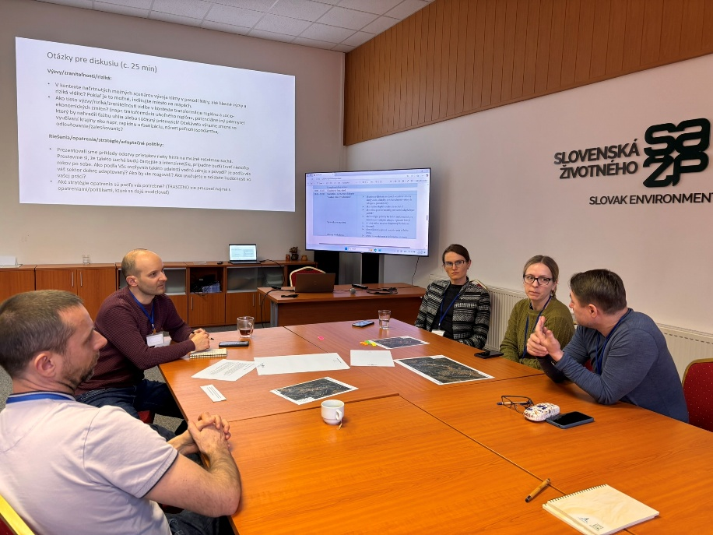
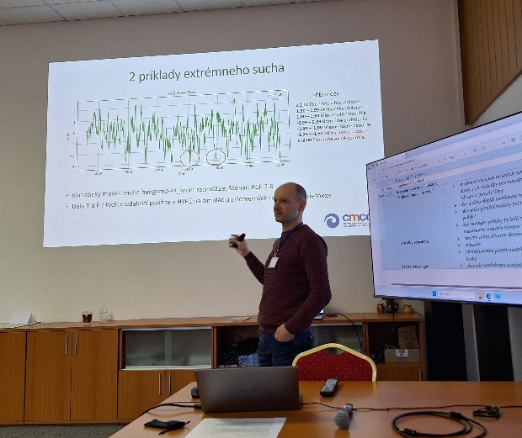
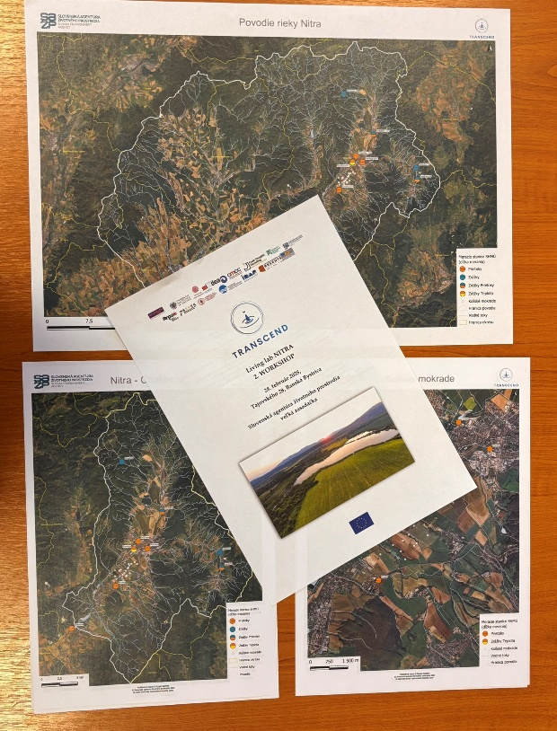
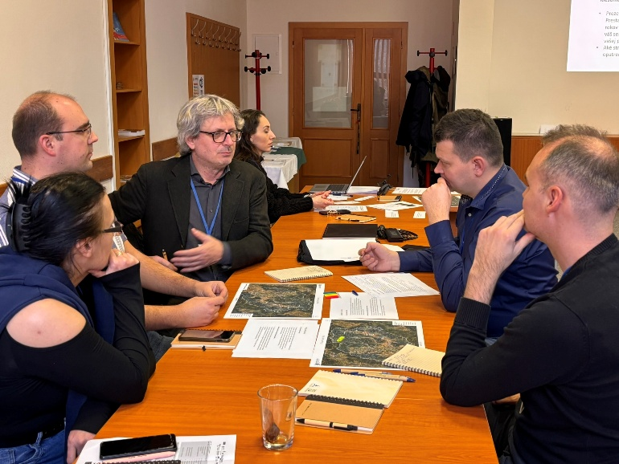
Transcend´s role
Transcend provides a platform connecting key stakeholders from different sectors - exchange experiences and knowledge
Expertise and training to build institutional capacity (climate scenarios and hydrological model for the basin)
Serious game
Opportunities
Scaling up the results to other river basins and living labs in Slovakia
Disseminate the results and approach through national adaptation platform (klima-adapt.sk)
Integrate the outputs of Transcend into CLIMAAX, LIFE NatAdaptSK

