Slide 1
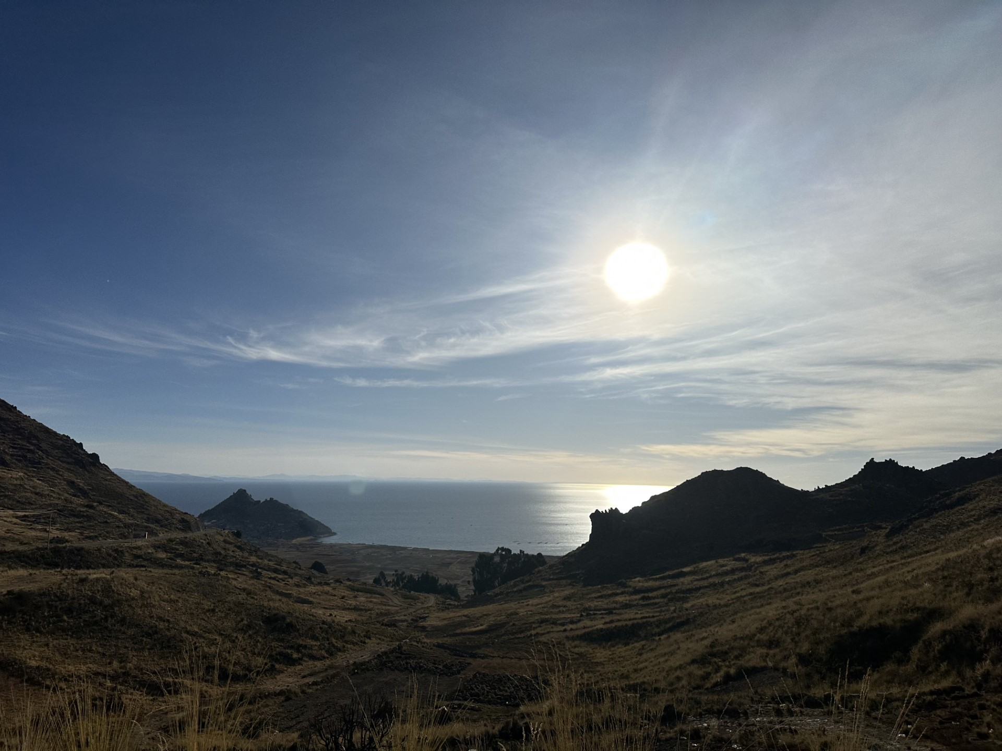
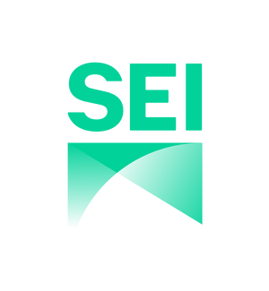
TRANSCEND
institutional capacity building
Living Lab – TDPS
April, 2026
Julio Cesar Miranda, Gustavo Ayala

Slide 2
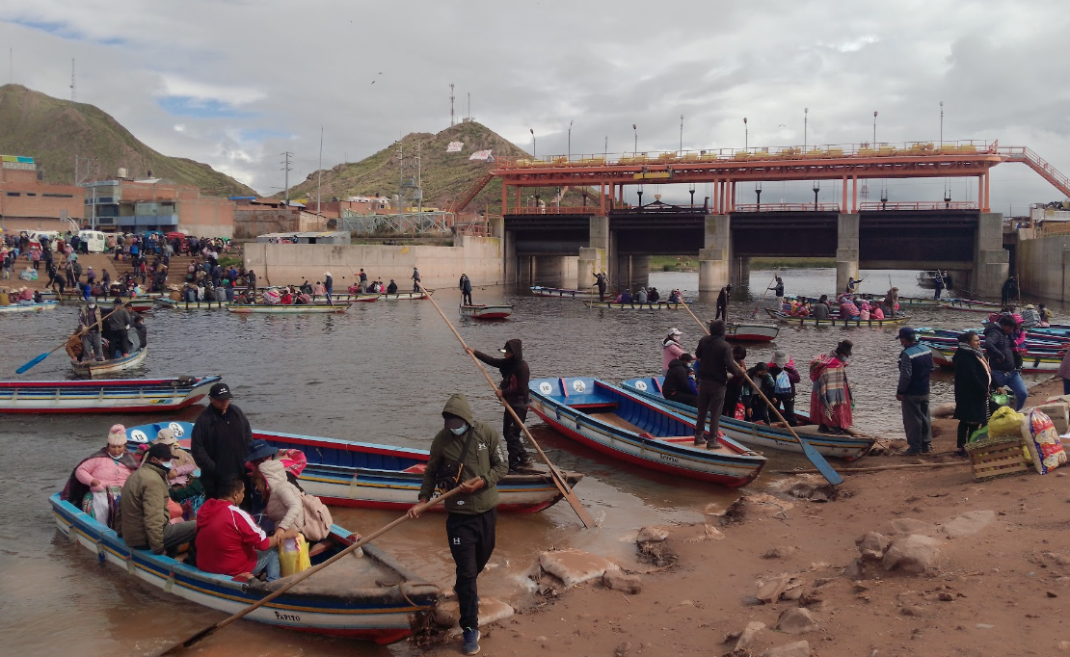
1. How is your region building institutional capacity for adaptation?
ALT's institutional capacity for adaptation encompasses monitoring, planning, technical interventions, and collaboration (water quality monitoring, fish biomass assessments, lake level tracking, and studies on pollution/eutrophication)

Slide 3
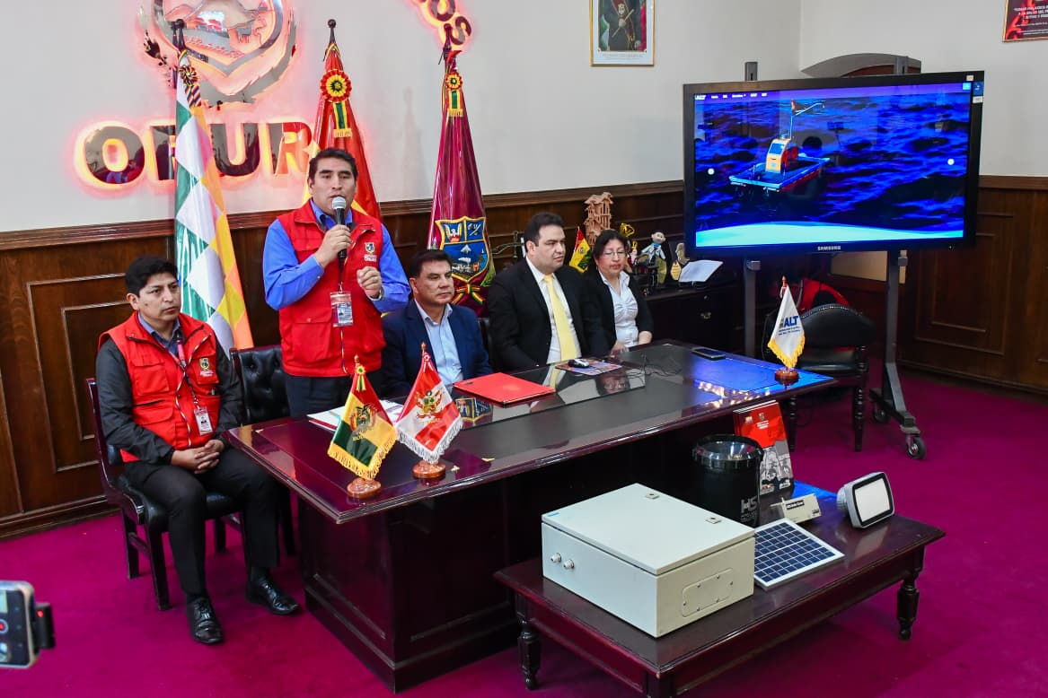
2. How do you keep your region informed about new opportunities to advance institutional capacity?
ALT regularly convenes workshops and international events that serve as platforms for sharing updates on projects, monitoring results, and emerging opportunities.
ALT launched the Observatorio Binacional Permanente del TDPS (OBP-TDPS). The observatory directly advances institutional capacity by enabling municipalities, NGOs, and local actors to access and use shared information for local projects.

