Slide 1




TRANSCEND 3nd Webstival
29/04/2026
Technical adaptation opportunities in the Tymbaki basin
Fotis Pantazoglou M.Sc.
Geologist – Systems Engineer MSc
This project has received funding from the
EU Horizon Europe Programme

Slide 2



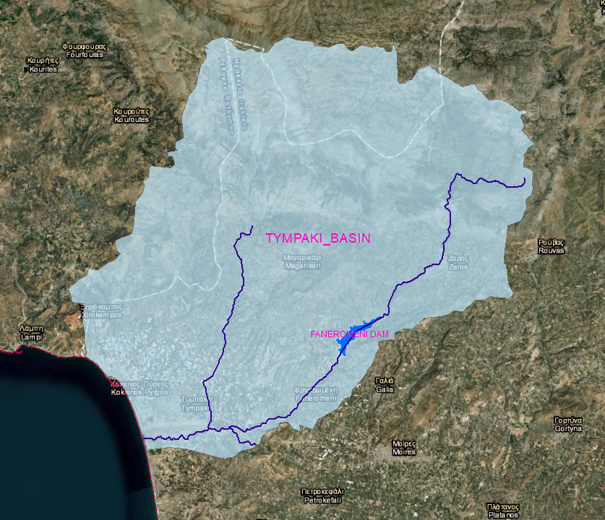
The Tympaki study area
The Tympaki study area extends over a hydrological basin of approximately 265 km² and, according to the classification framework of the Water Framework Directive (WFD), comprises seven lotic water bodies and six groundwater bodies. The basin constitutes a subsection of the broader Messara plain in southern Greece, which represents the principal agricultural production zone of the island of Crete.
From a physiographic perspective, the basin consists of two distinct geomorphological units: the Tympaki alluvial plain to the west and the upland Tympaki hills to the east. It is traversed by the Geropotamos River system, including its Koutsoulidis and Mageiros tributaries. The alluvial plain of Tympaki serves as the predominant locus for groundwater abstraction.

Slide 3
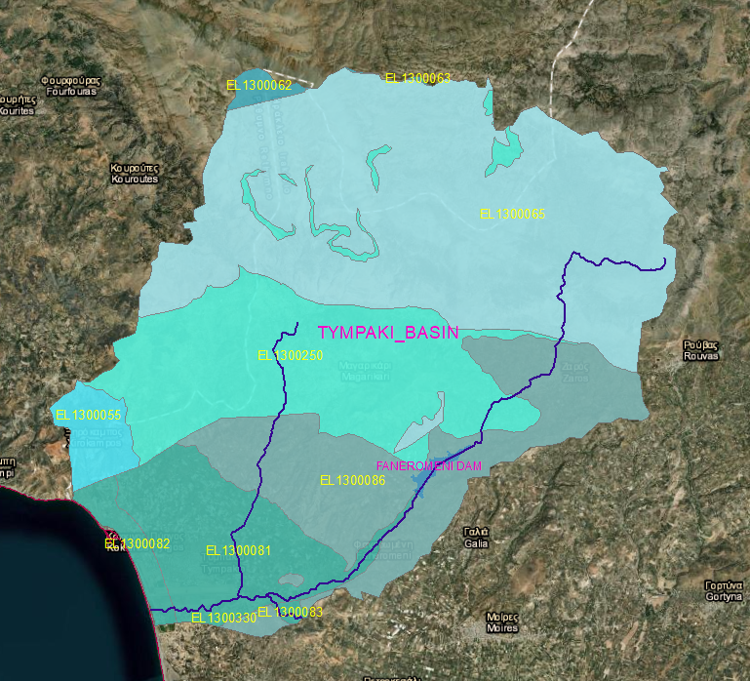
The Tympaki study area
Land use within the Tympaki basin is predominantly agricultural, covering approximately 40% of the total basin area and reaching 88% within the central Tympaki plain. The broader Tympaki region hosts an estimated population of roughly 11,000 residents. Groundwater constitutes the primary irrigation source, with annual abstractions on the order of 7.5 million m³ to support cultivation over an area of approximately 40 km² in the central plain. Supplementary irrigation water is also supplied from the Faneromeni Dam.
Regarding groundwater resources, two of the six classified groundwater bodies exhibit poor quantitative status. In particular, groundwater body EL1300082 is subjected to pronounced pressures from intensive irrigation pumping, resulting in significant hydrogeological impacts including salinization, seawater intrusion, and both quantitative depletion and qualitative deterioration. Similarly, groundwater body EL1300081 experiences substantial over-extraction for agricultural use, inducing comparable declines in both water quantity and quality.

Slide 4
Scenarios used in the SG
Hydrological Scenarios
a. Reference scenario(Baseline hydrological conditions for the period 1980–2022. Existing land uses, management practices, and infrastructure.)
b. −10% Precipitation (Climate scenario in which precipitation during the historical period is reduced by 10% to simulate future climatic conditions.)
c. −20% Precipitation (Climate scenario in which precipitation during the historical period is reduced by 20% to simulate future climatic conditions.)
d. Severe drought: 5 consecutive dry years (Stochastic climate scenario with periods of five consecutive dry years to simulate more severe future droughts.)
e. Prolonged drought: 7 consecutive dry years(Stochastic scenario with periods of seven consecutive dry years to simulate prolonged future droughts.)
Infrastructure Scenarios
a. Infrastructure reference scenario (Baseline hydrological conditions for the period 1980–2022. Existing land uses, management practices, and infrastructure.)
b. Platis River diversion + PWSS expansion (Diversion of water from the Platis River to the Faneromeni Dam. Expansion of the existing irrigation system (PWSS) to cover additional areas supplied with water from the dam.)

Slide 5
Scenarios used in the SG
Economic Scenarios
a. Reference scenario (Current allocation rules and tariffs remain unchanged. Stable framework without incentives for improvement.)
b. Increase in olive oil price (+30%) (Increase in the international olive oil price, resulting in higher profits for farmers, but a potential increase in over-abstraction.)
c. Decrease in olive oil price (−30%) (Decrease in price, leading to reduced profits and increased economic pressure on farmers.)
d. Increase in water cost (+0.5 €/m³) (Higher water price encourages water saving but reduces agricultural profit.)
e. Increase in water cost (+1 €/m³) (Even greater reduction in water consumption but significant impact on agricultural profits.)
Management Scenarios
a. All olive trees are irrigated (All olive trees receive irrigation. This scenario creates high pressure on irrigation infrastructure and aquifers, increasing the risk of overexploitation and seawater intrusion. Other sectors may face water shortages, and conflicts among users may be intense.)
b. All olive trees are cultivated without irrigation (Olive trees are cultivated without irrigation. This reduces pressure on groundwater aquifers, but farmers become dependent on rainfall and more vulnerable to drought. This scenario cannot be associated with the diversion of water from the Platis River to the Faneromeni Dam.)
c. Increase in avocado cultivation (Increase in high-value crops such as avocado. Five percent of irrigated olive trees have been replaced by avocado trees in the central part of the Tympaki basin. This crop generates higher income but requires increased irrigation demand.)

Slide 6
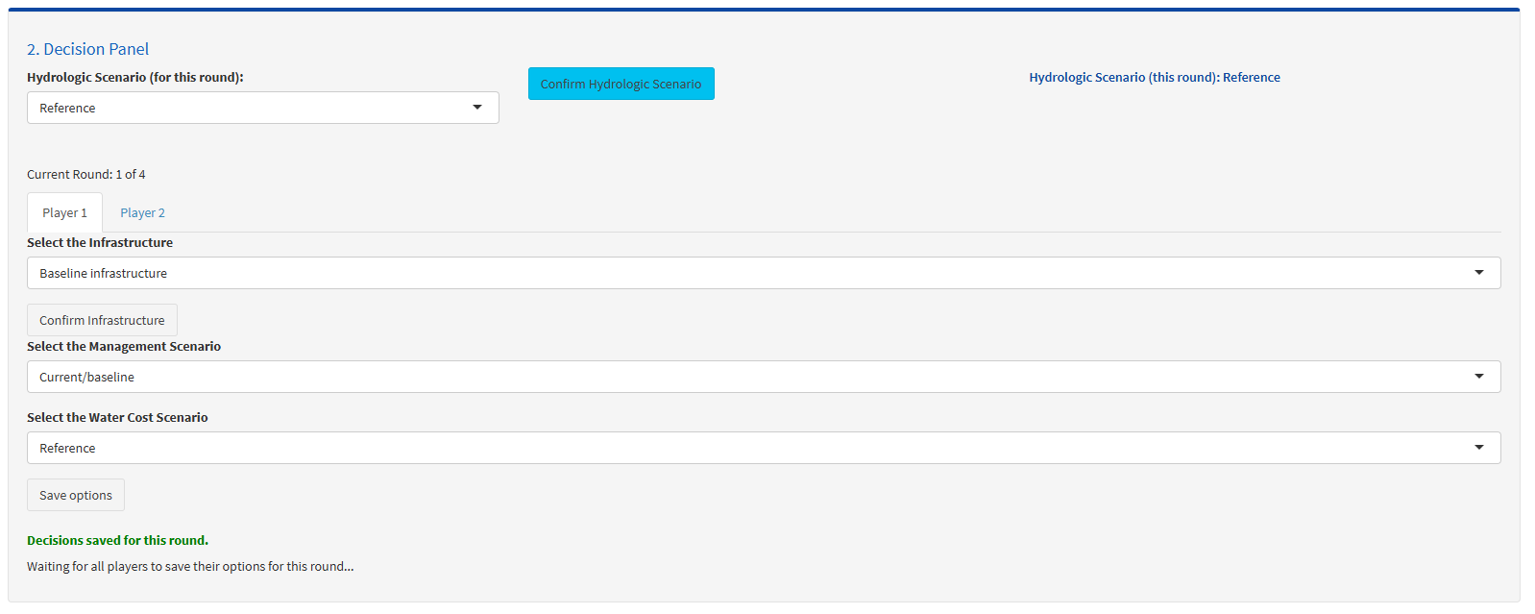
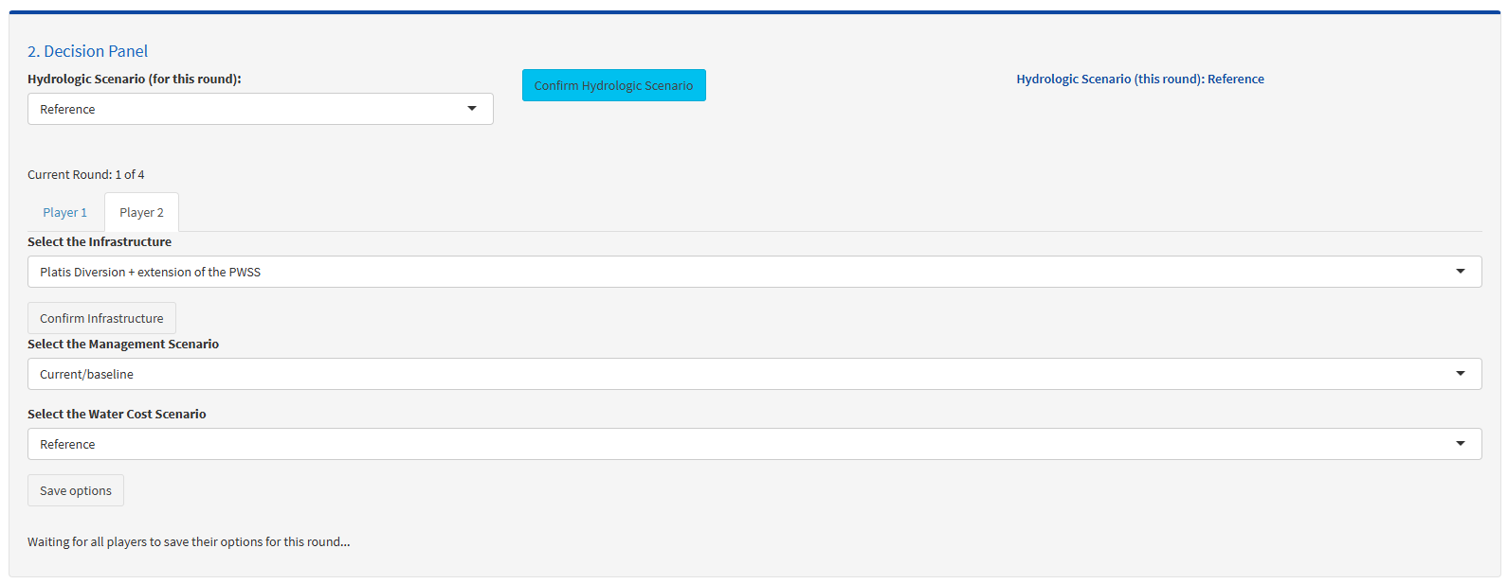
Some SG…results
Reference infrastructure
Adding Platis Dam & diversion

Slide 7
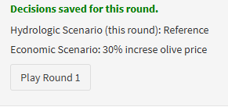
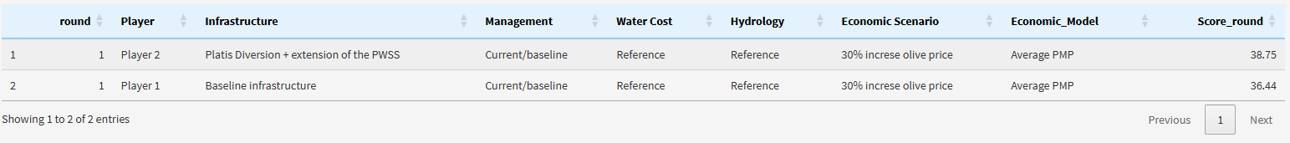
Some SG…results
Economic scenario (randomly choose by the game)
…and the “winner” is…
Ooops…is there an opportunity?????

Slide 8
What do the stakeholders think about?
Construction of dams and diversion of water. (Platis river case)
Projects for groundwater recharge with small-scale water storage projects. (Mageras River)
Control and reduction of losses and leakages in water networks.
Use of modern technology and AI for better water management in the area.
Reuse of treated wastewater through wastewater treatment plants (WWTPs).

Slide 9
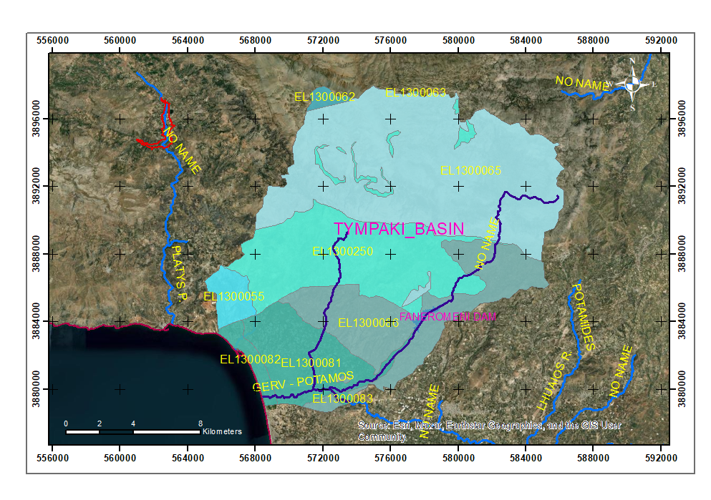
Technical adaptation opportunity of the Platis river dam
Platis Dam

Slide 10
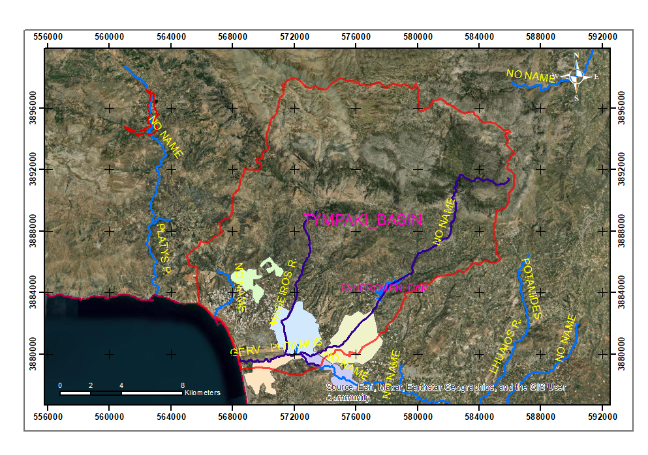
Technical adaptation opportunity of the Platis river dam
Platis Dam
1.Increase of irrigated area
2.Increase of crop production
3.Increase of income

Slide 11
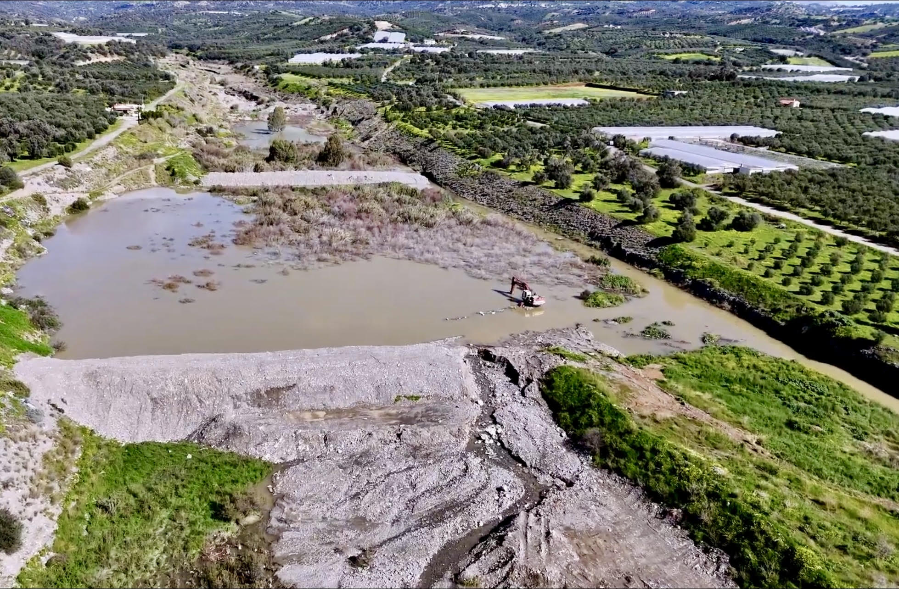
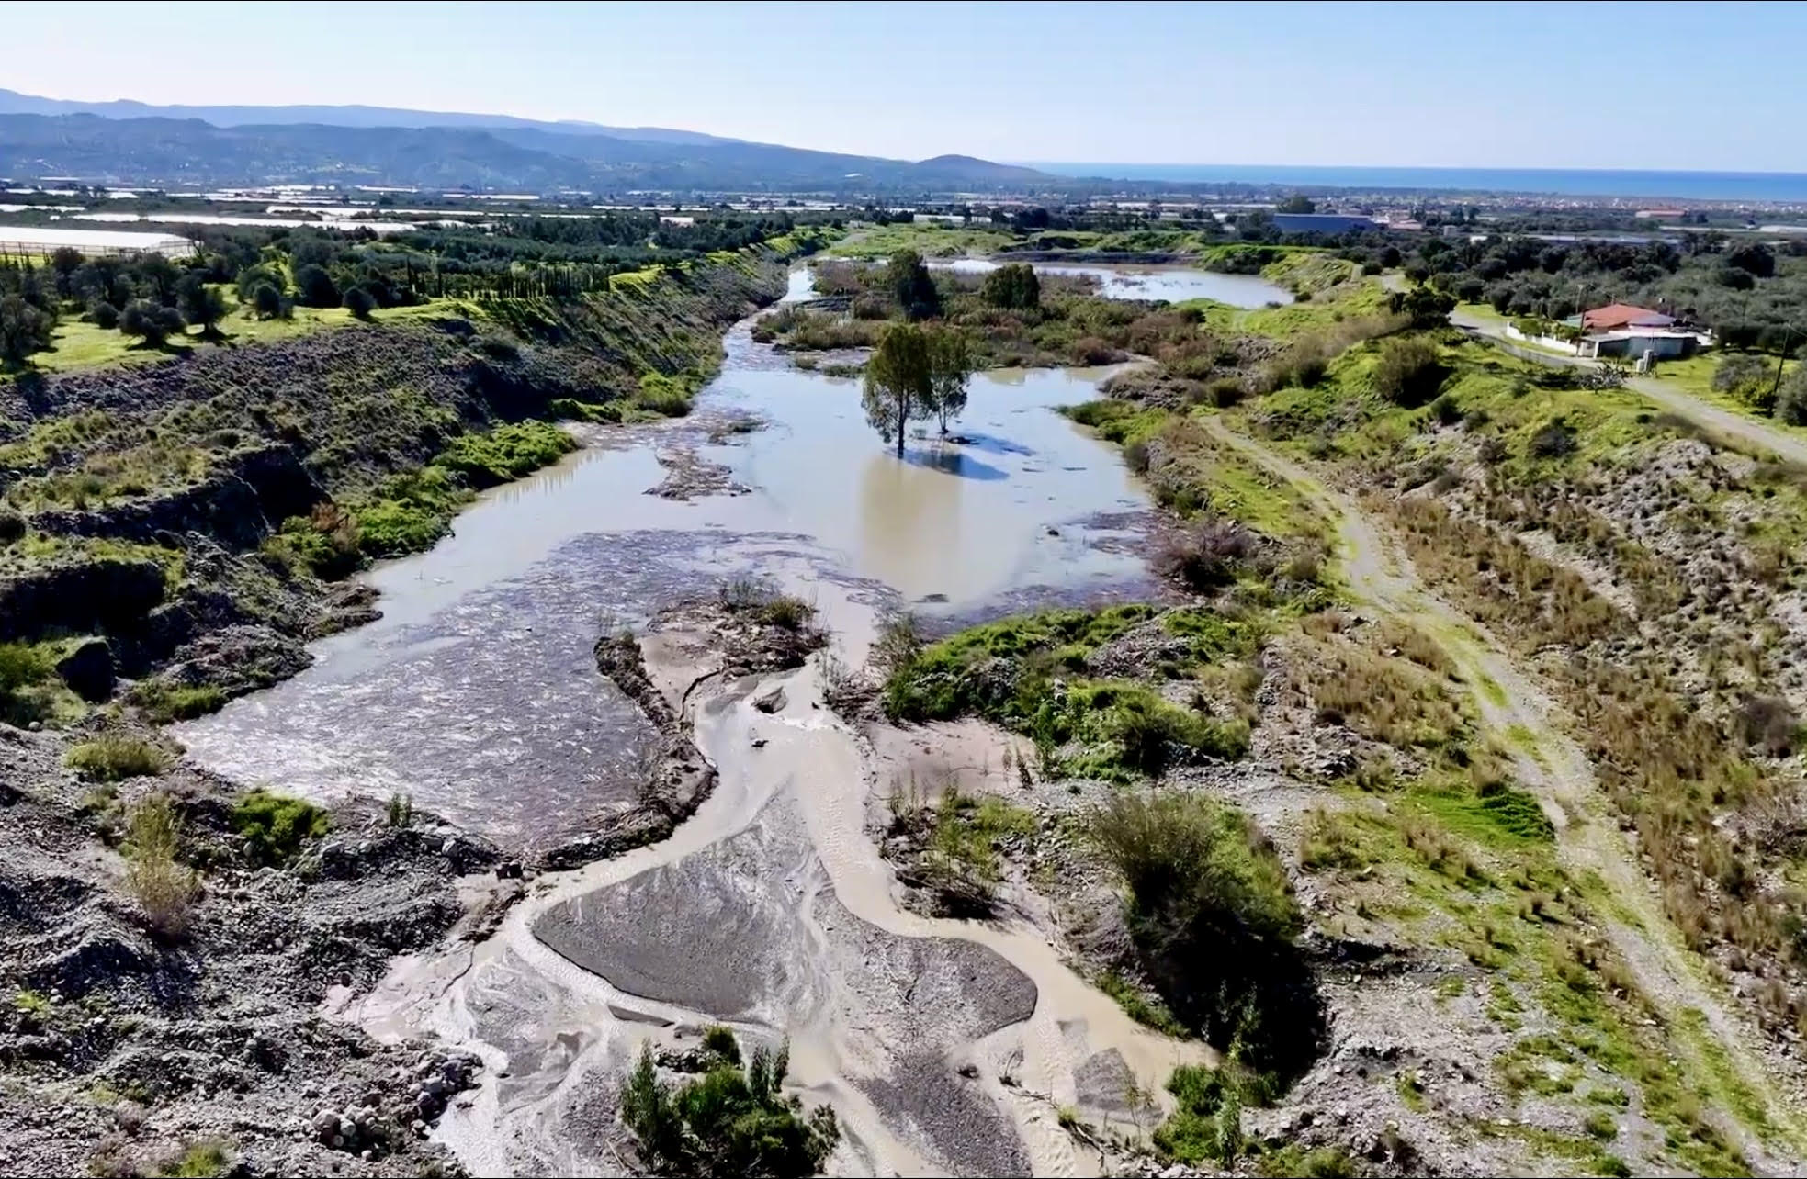
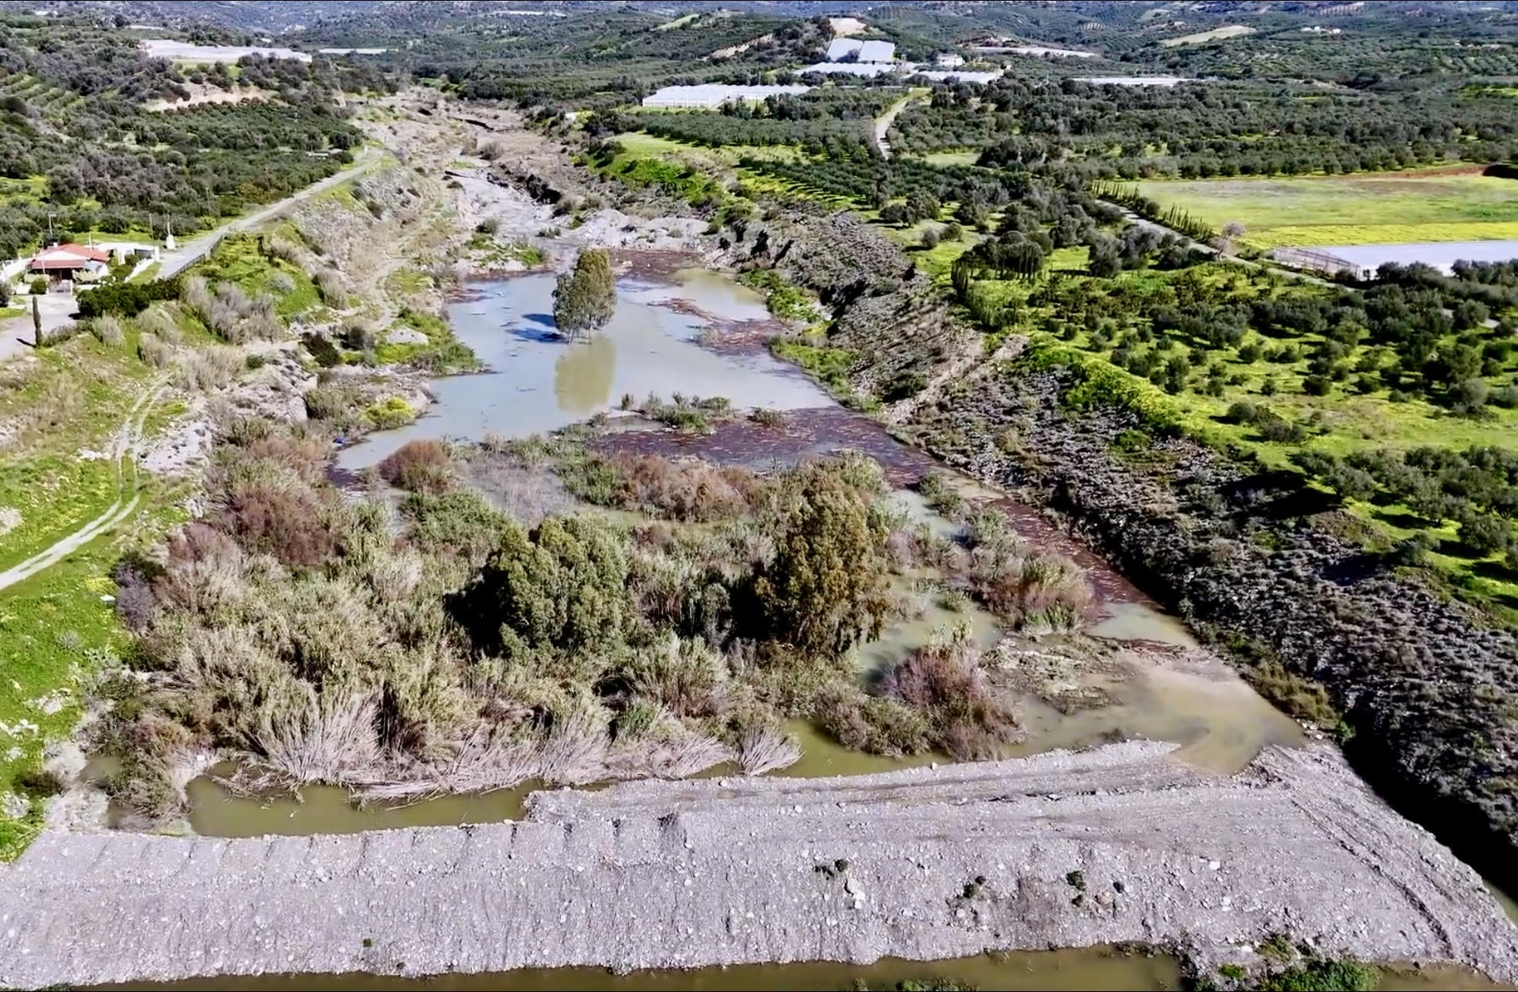
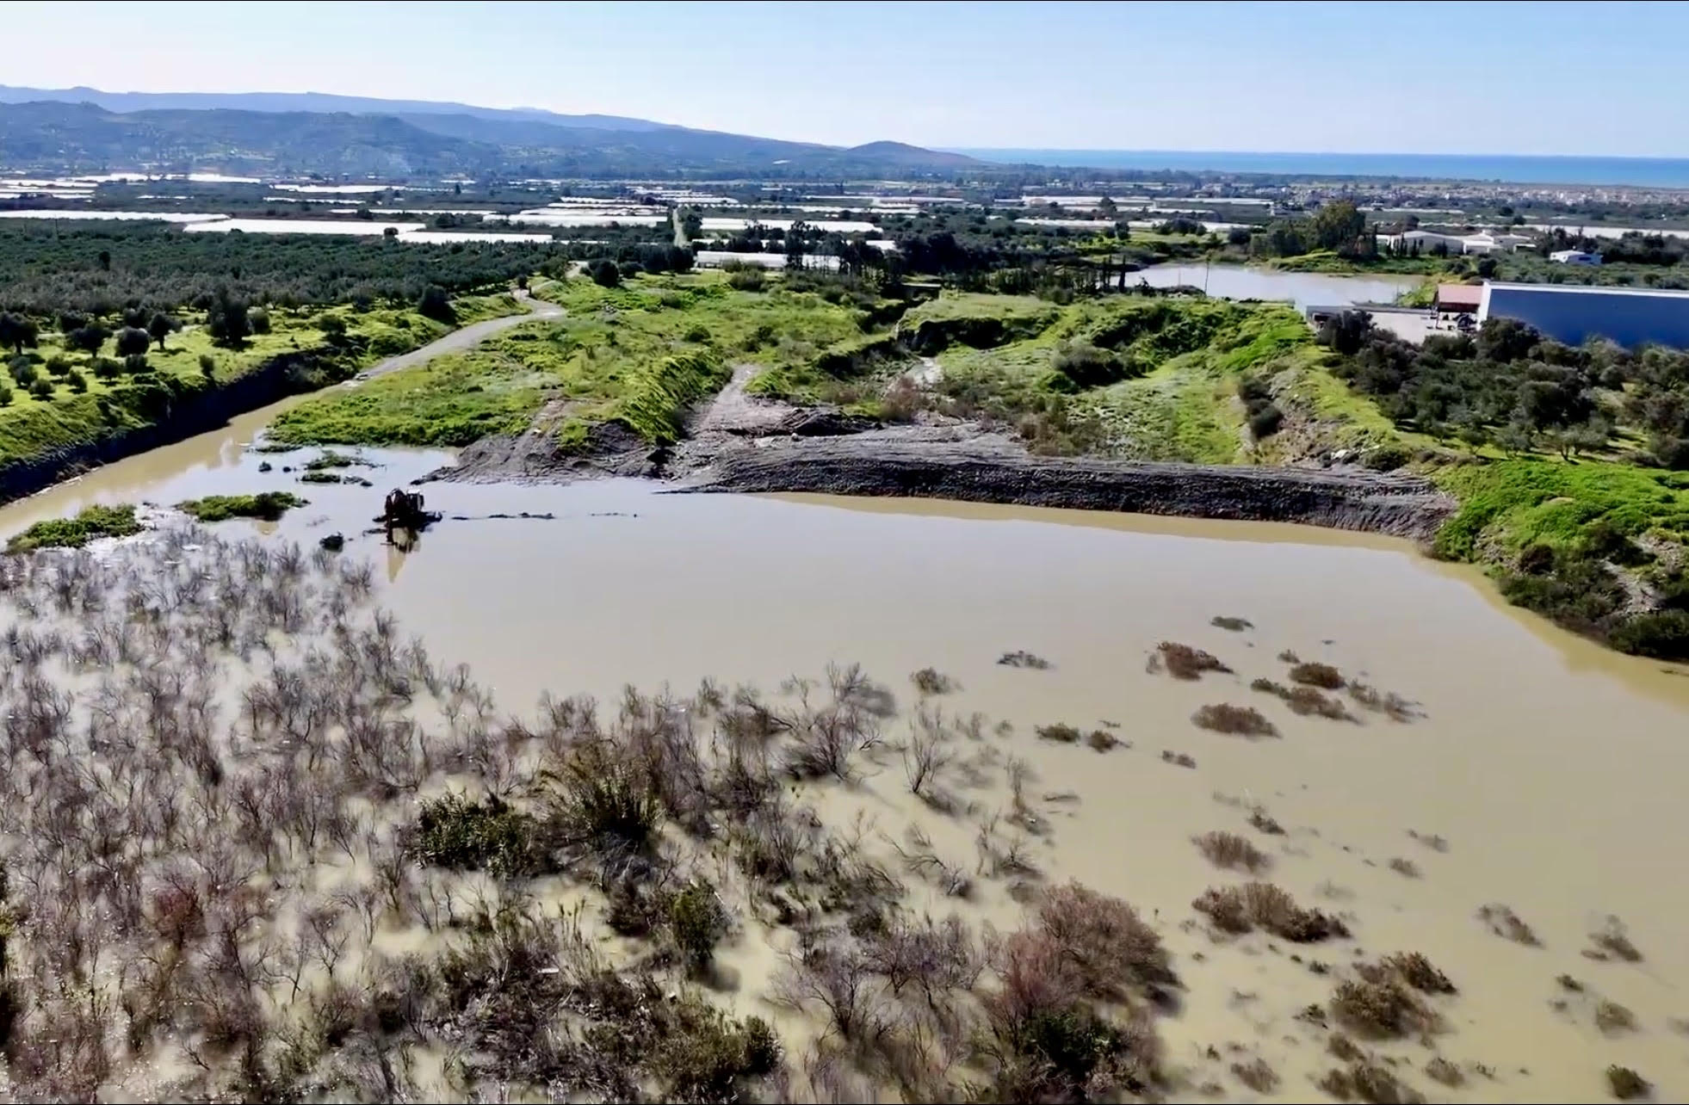
Technical adaptation opportunity
Projects for groundwater recharge with small-scale water storage projects. (Mageras River)

Slide 12
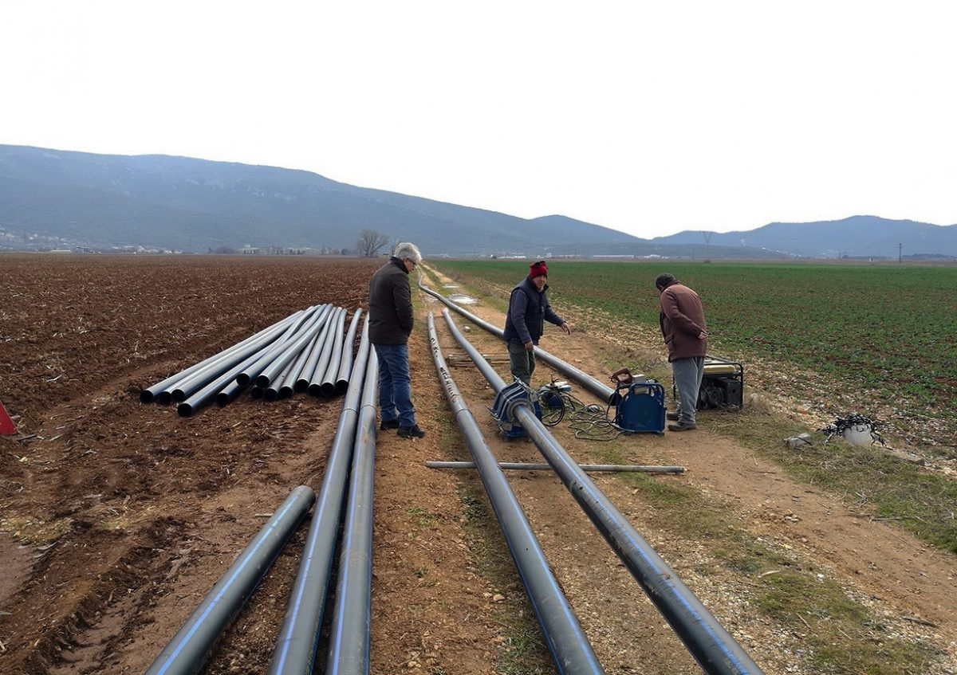
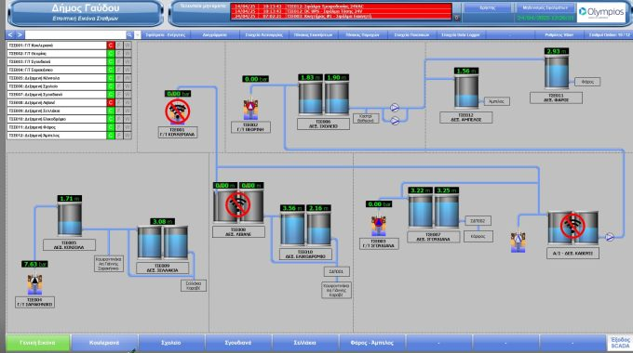
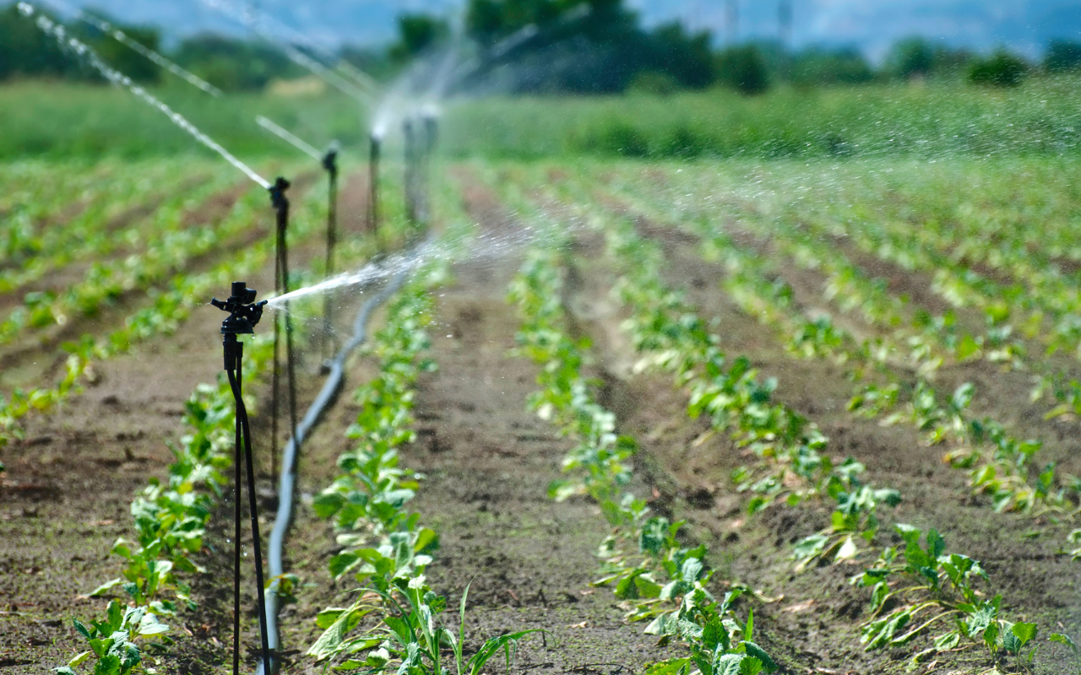
Technical adaptation opportunity
Control and reduction of losses and leakages in water networks with the use of modern technology and AI for better water management in the area.

Slide 13
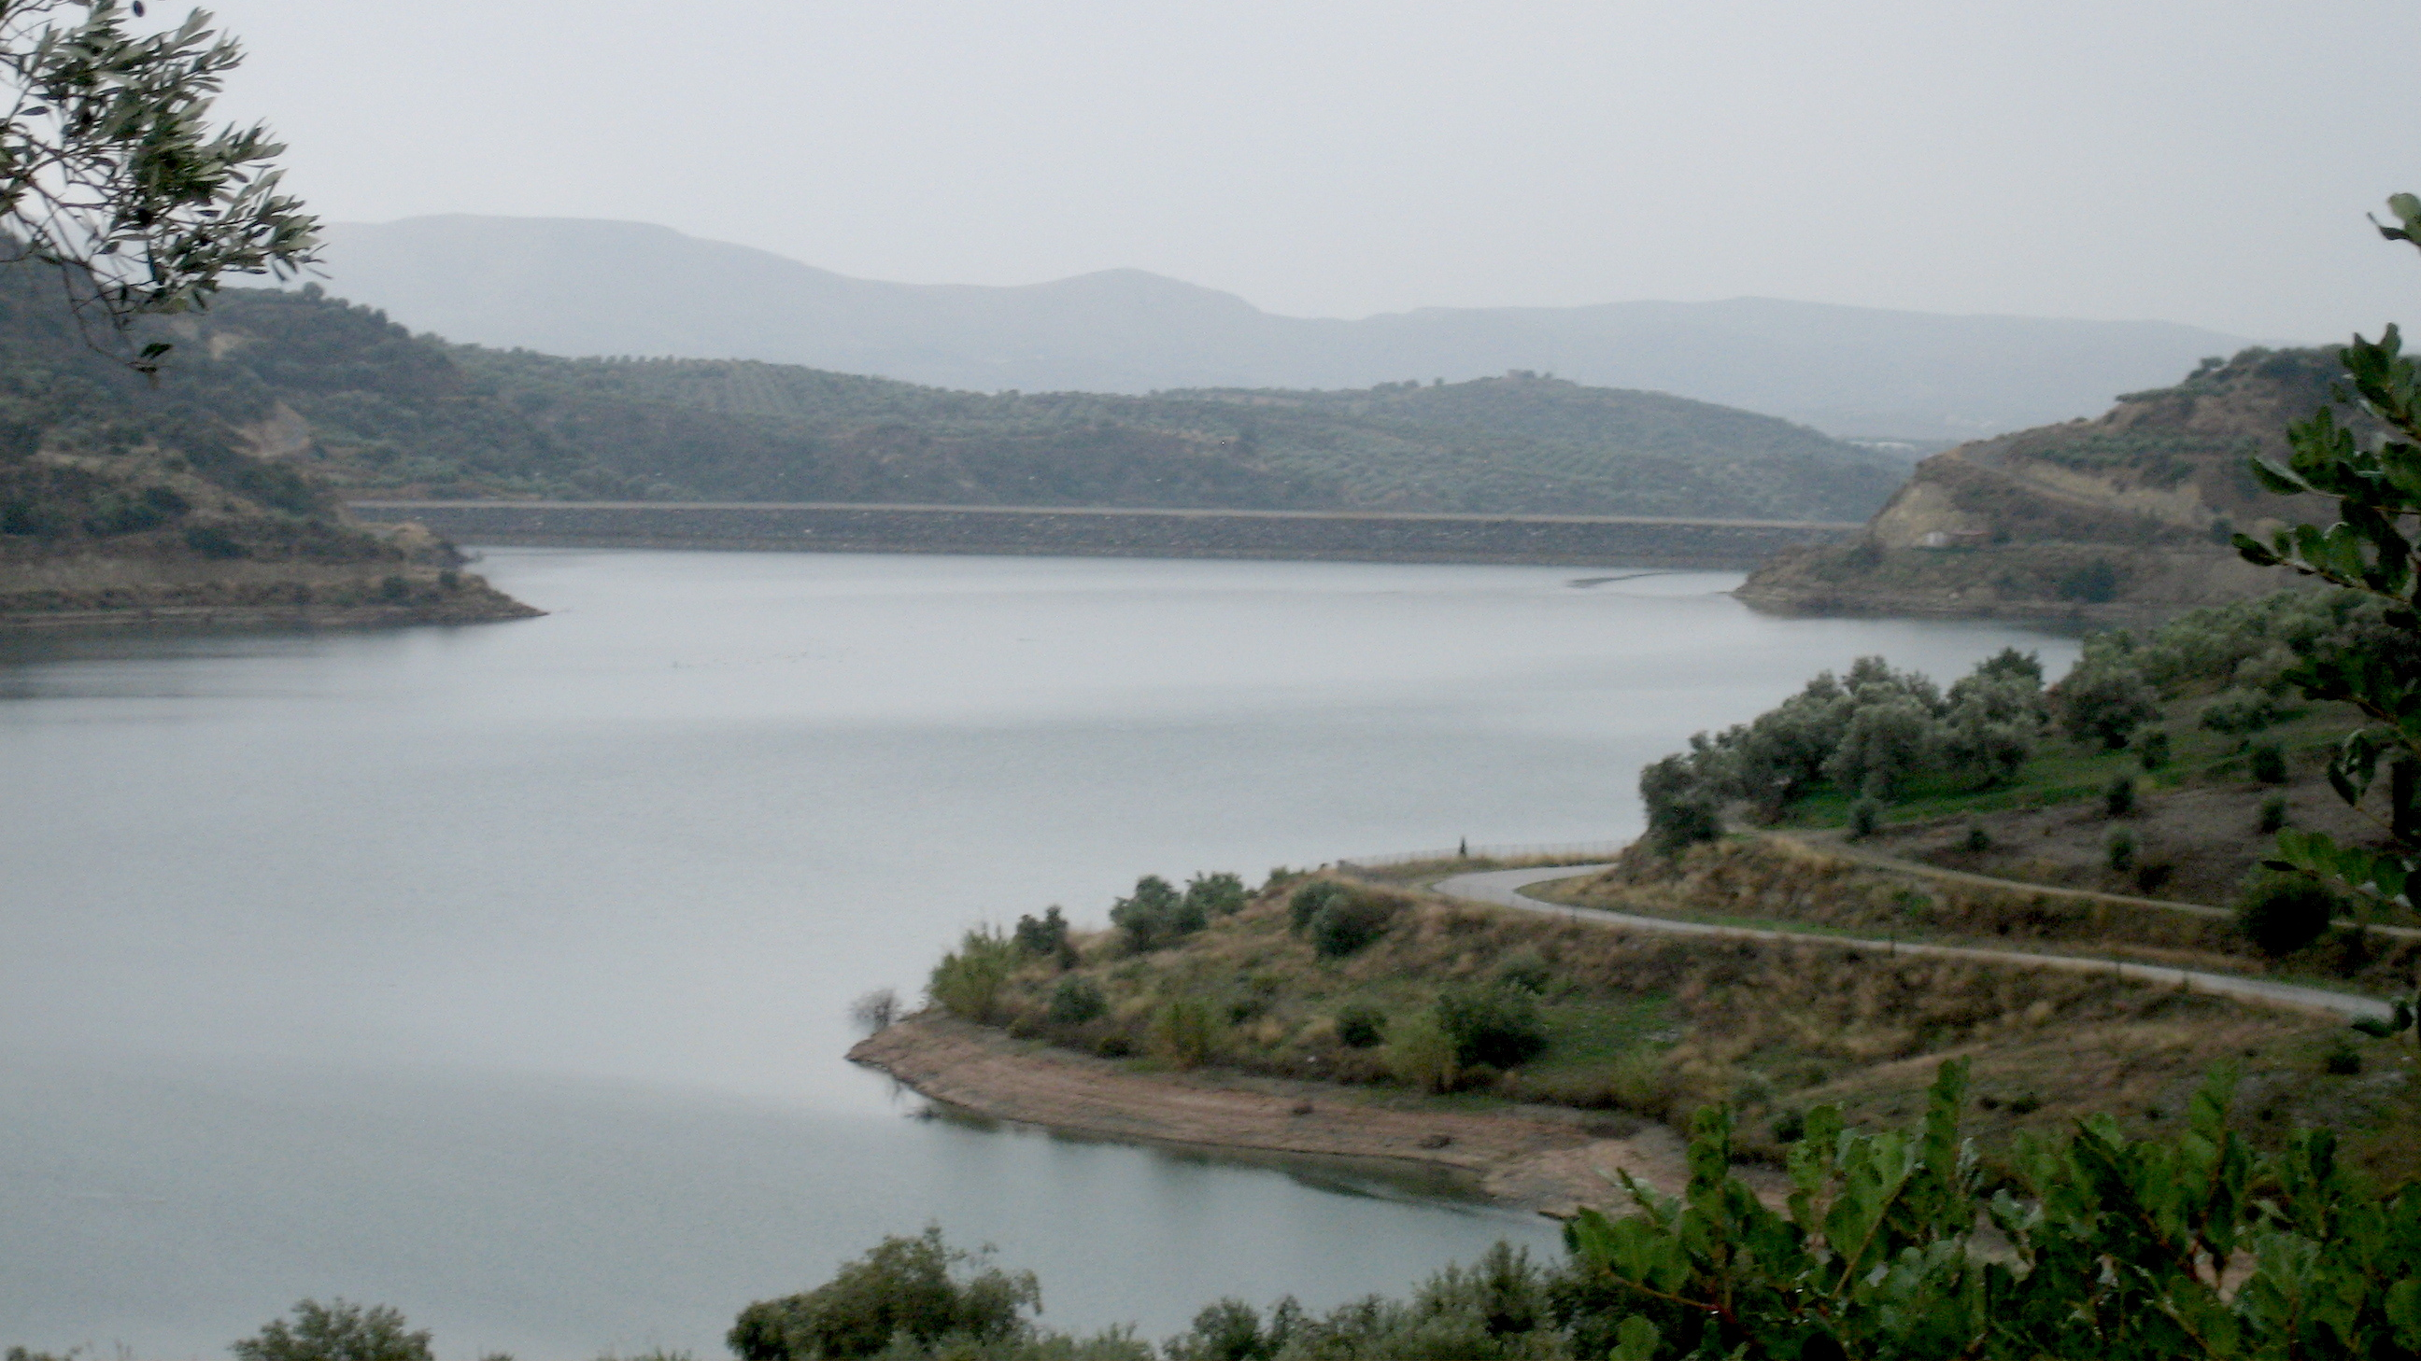
Thank you!!!

