Slide 1






TRANSCEND 3rd Webstival
Technical capacity building in the Reno River basin
Emilia-Romagna, Italy
Alice Vecchi - ARPAE Climate Observatory

Slide 2
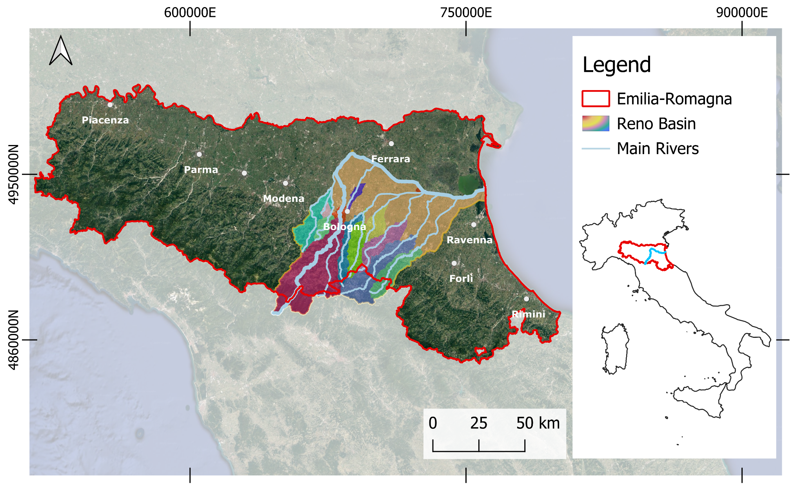


Reno River basin
4,628 km²
Plain and mountain landscape; from temperate Mediterranean to mountain climate
Anthropic and vulnerable landscape: dams for hydropower use in the mountain part and channels for agriculture in the plain
Main land use: agriculture (55%); main water use: irrigation (80%)
Growing climate risk (drought and floods) exacerbated by climate change
Ecosystems (wetlands, forests, rivers) that benefit from water wastes of traditional irrigation at risk for new efficient technologies
Notes:
Un bacino importante come estensione, raccoglie dalla montagna verso il mare…. gestito da arpae e cmcc e altri partner (modelli climatici e idrologici)

Slide 3


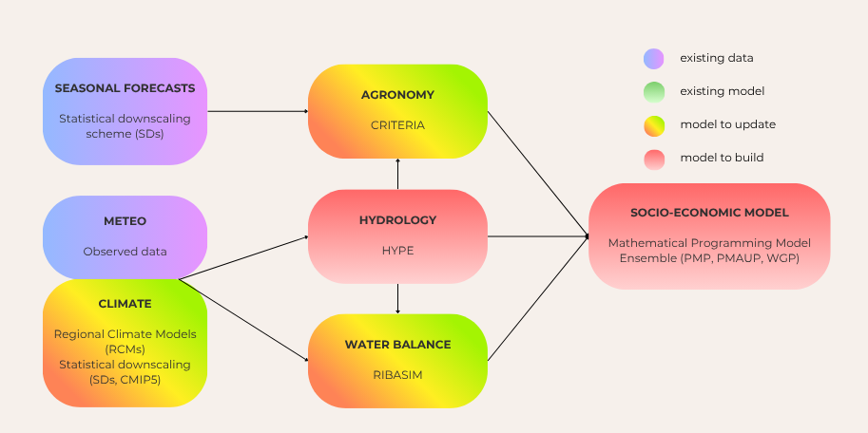
How is your region building technical capacity?
The TRANSCEND project in the Reno Living lab so far
3 stakeholder workshops
30 stakeholders
15 different typologies including Emilia-Romagna Region
technical capacity among main gaps highlighted
modeling suite at the beginning of the project

Slide 4
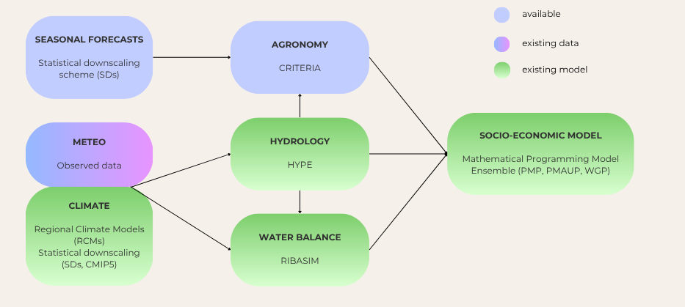
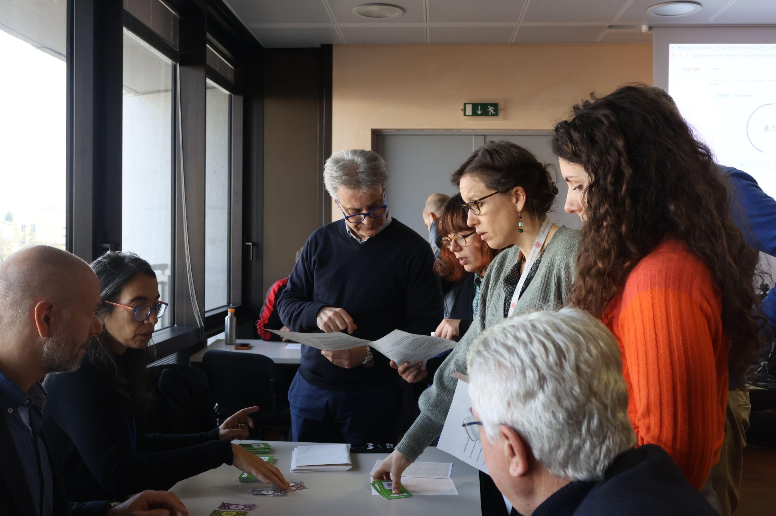
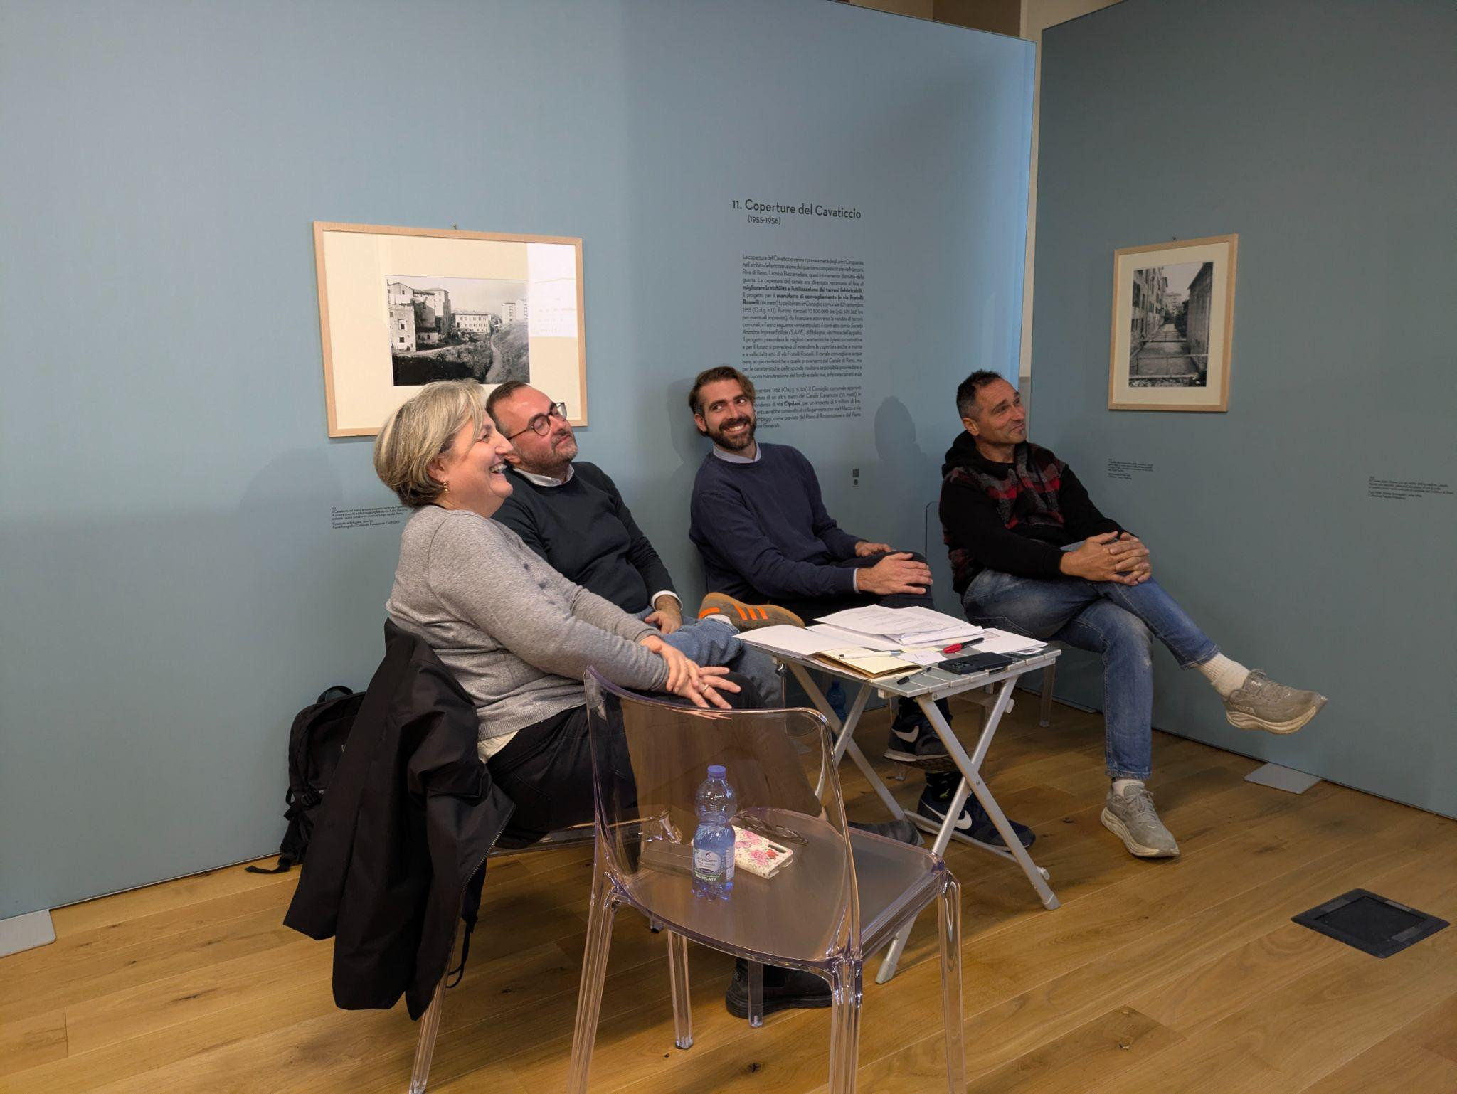
modeling suite developed within the project
serious game 1 (2nd workshop)
serious game 2 (3rd workshop)
Notes:
a voce i due punti di capacity: più modelli e migliore comprensione degli stessi

Slide 5
Update of the Regional Climate Adaptation and Mitigation Strategy
Update of the Climate Mitigation and Adaptation Strategy
Climate Risk Assessment
Regional Plan for Mitigation and Adaptation
by the end of 2026
by mid-end 2027
Climate risk assessment of three key risks using CLIMAAX methodology, always associated with local data and, when available, tools:
Drought (agricultural and relative)
Floods (fluvial and coastal)
Heatwaves
Notes:
dire che cra è parte della strat che aiuterà a build il plan con quantitative data

Slide 6
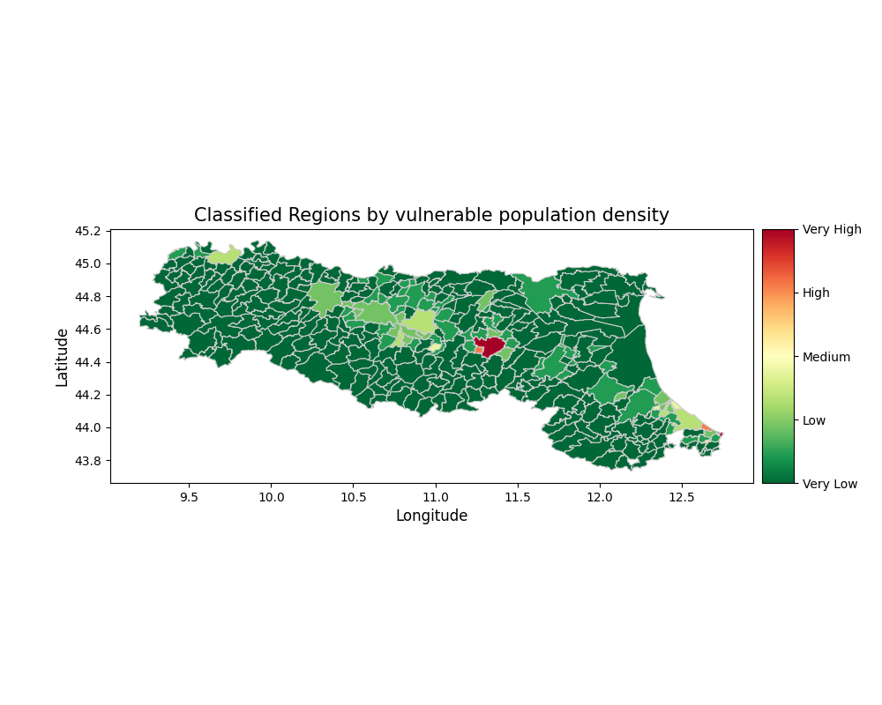
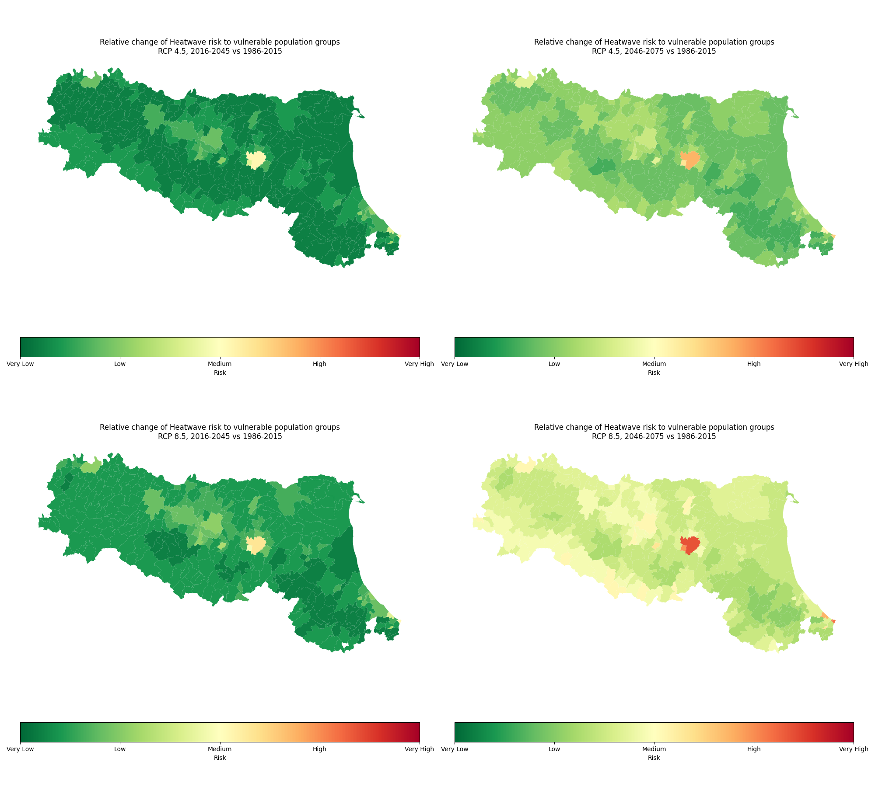
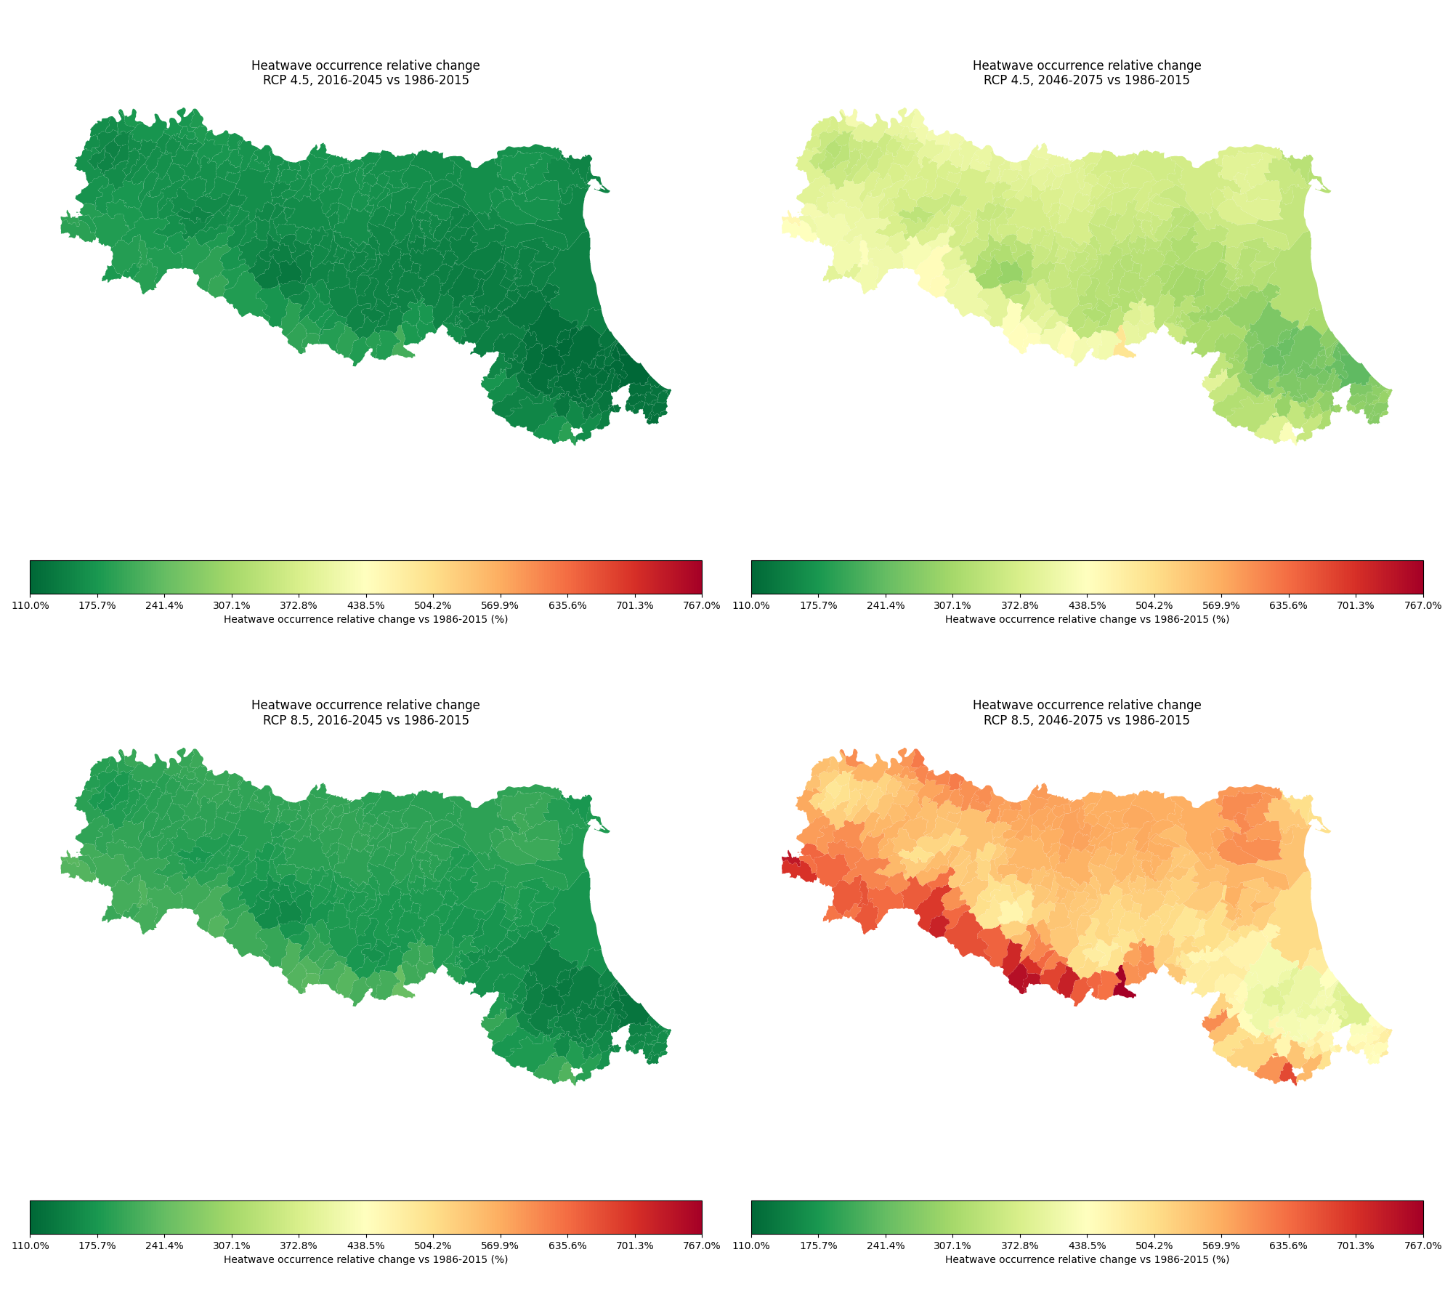

Heatwaves - Risk projections
OUTPUT: Projected risk map for two RCP scenarios for the periods 2016-2045, 2046-2075. →Two corresponding SSP scenarios for 2036-2065
EXPOSURE + VULNERABILITY map: vulnerable population data maps (Worldpop Hub) → to be replaced with local data
HAZARD maps: Copernicus Climate Data Store Heat waves and cold spells in Europe derived from climate projections (bias-adjusted EURO-CORDEX dataset). Scenarios RCP 4.5 and 8.5. Resolution 12x12km → to be replaced with local climate data and scenarios
Notes:
dataset mondiale con pop per comune e fasce di età: la pop. noi useremo indicatori socio-sanitari locali, es anziani soli, malati, distanza da ospedali ecc

Slide 7
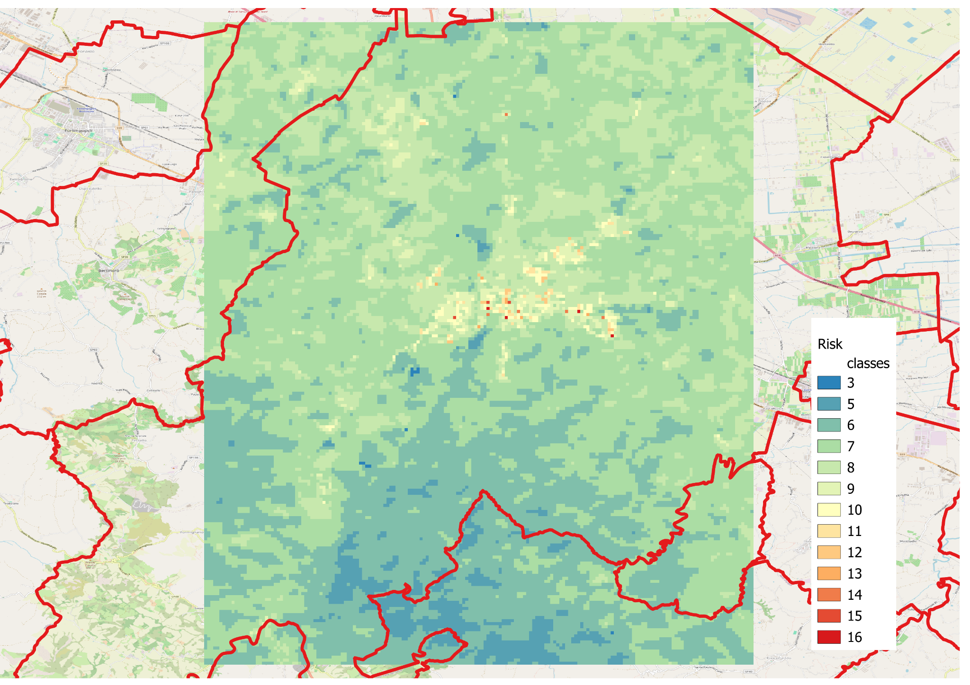
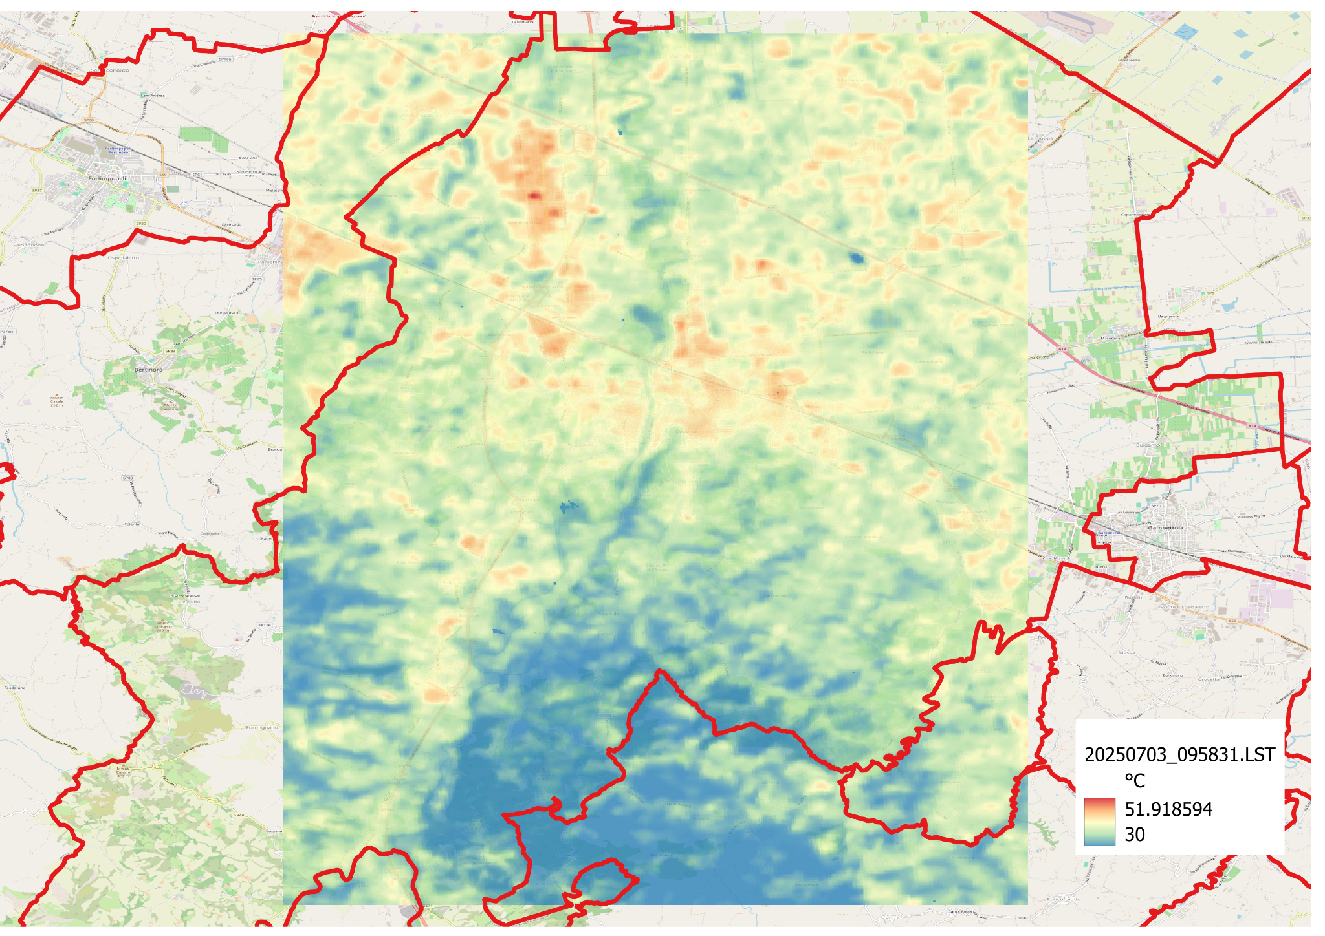
Heatwaves - Microscale
OUTPUT: High resolution (30 m) current risk map
EXPOSURE + VULNERABILITY map: vulnerable population data maps (Worldpop Hub) → to be replaced with local data
HAZARD: High resolution (30 m) LST (Land Surface Temperature) from Landsat IR imagery series.

Slide 8
How do you keep your region informed about new opportunities to advance technical capacity?
Update and new calibration of RIBASIM water balance model, to be used at the regional level, beyond the project’s objectives and scales, in an operative framework
scale-up of results and methodologies
synergies among projects and partners: the update of the Regional Strategy replicates and strengthens the collaboration among partners (ARPAE and CMCC), stakeholders (in particular E-R Region), and projects (CLIMAAX, P2R, ASPECT)

