Slide 1
Building the institutional capacity to design and implement transformational climate resilience pathways
Experience from Pathways2Resilience
Thomas KOETZ, Climate KIC

Slide 2
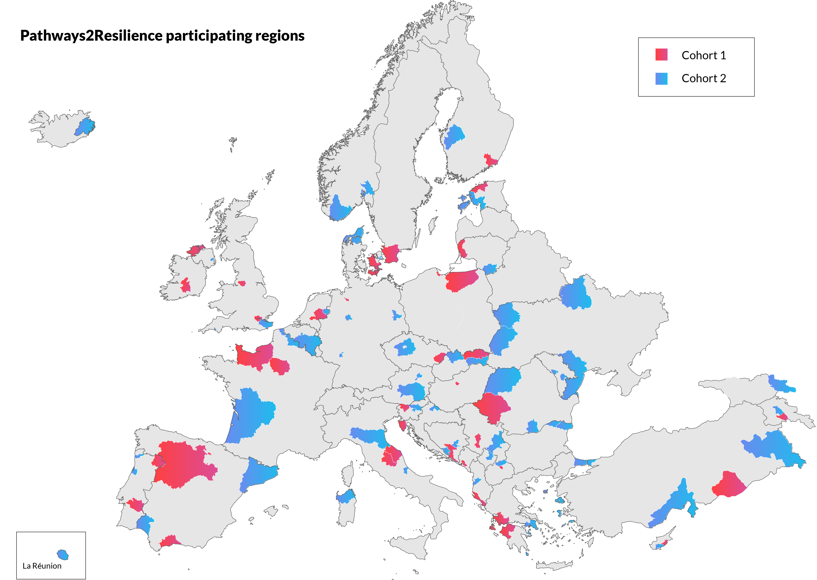

Pathways2Resilience P2R
P2R’s main objective is to empower 100 European regions and communities to formulate pathways to transformative adaptation
  climate resilient strategies, action plans, and investment plans
  capacity and capabilities to lead the transition to climate resilience
100 regions & communities
from 38 countries

Slide 3
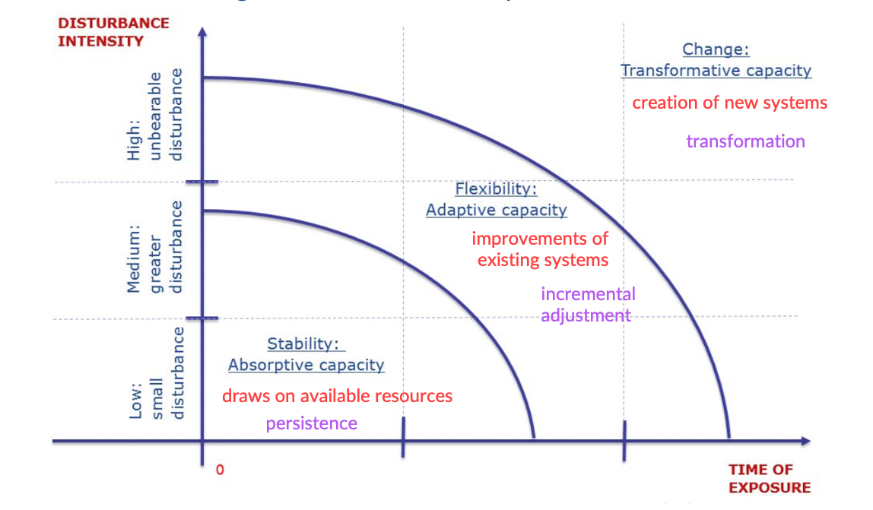
Transformative Adaptation
Adapted from European Commission Joint Research Centre: Manca, Benczur and Giovannini, Building a scientific narrative towards a more resilient EU society, Part 1: a conceptual framework, EUR 28548 EN, doi:10.2760/635528

Slide 4
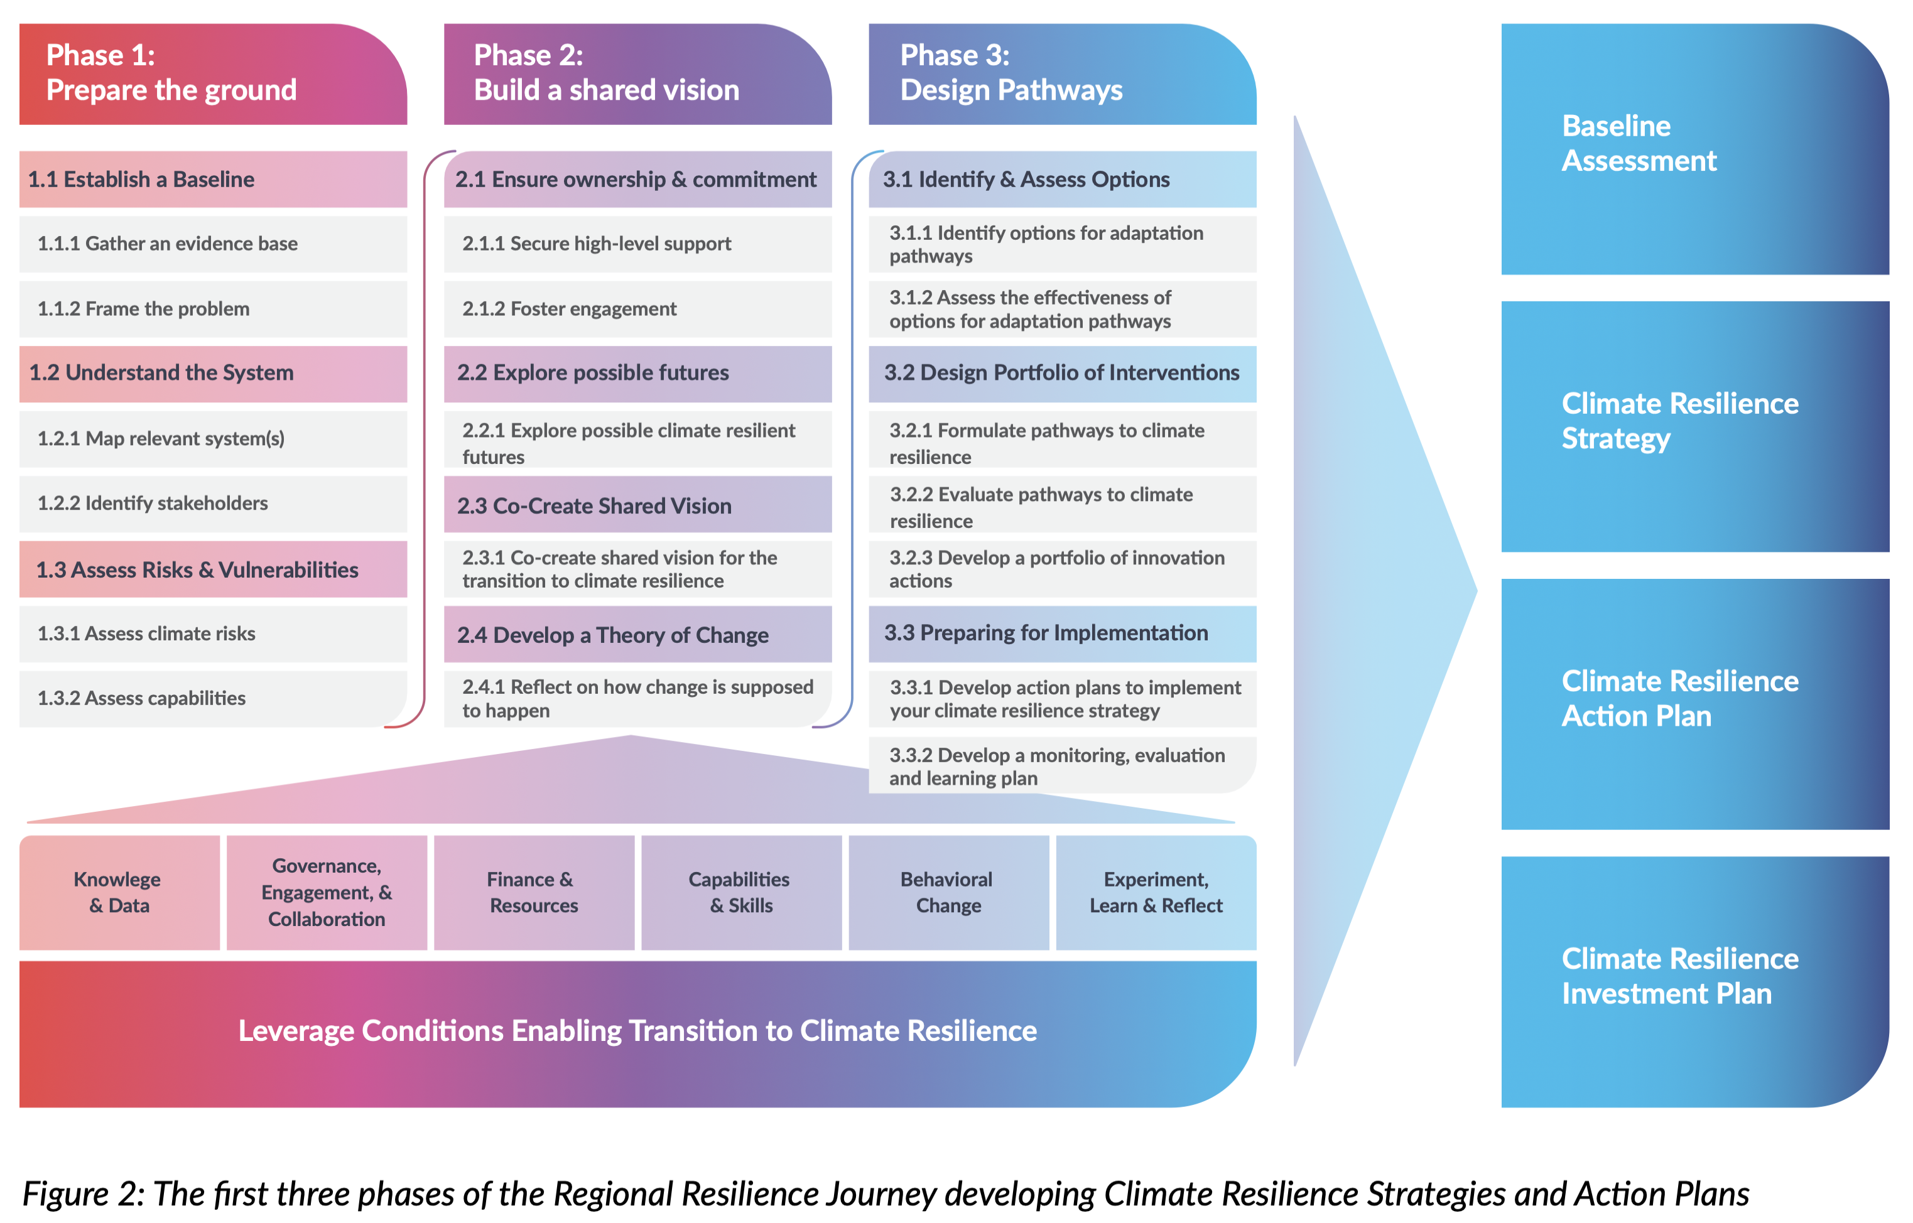
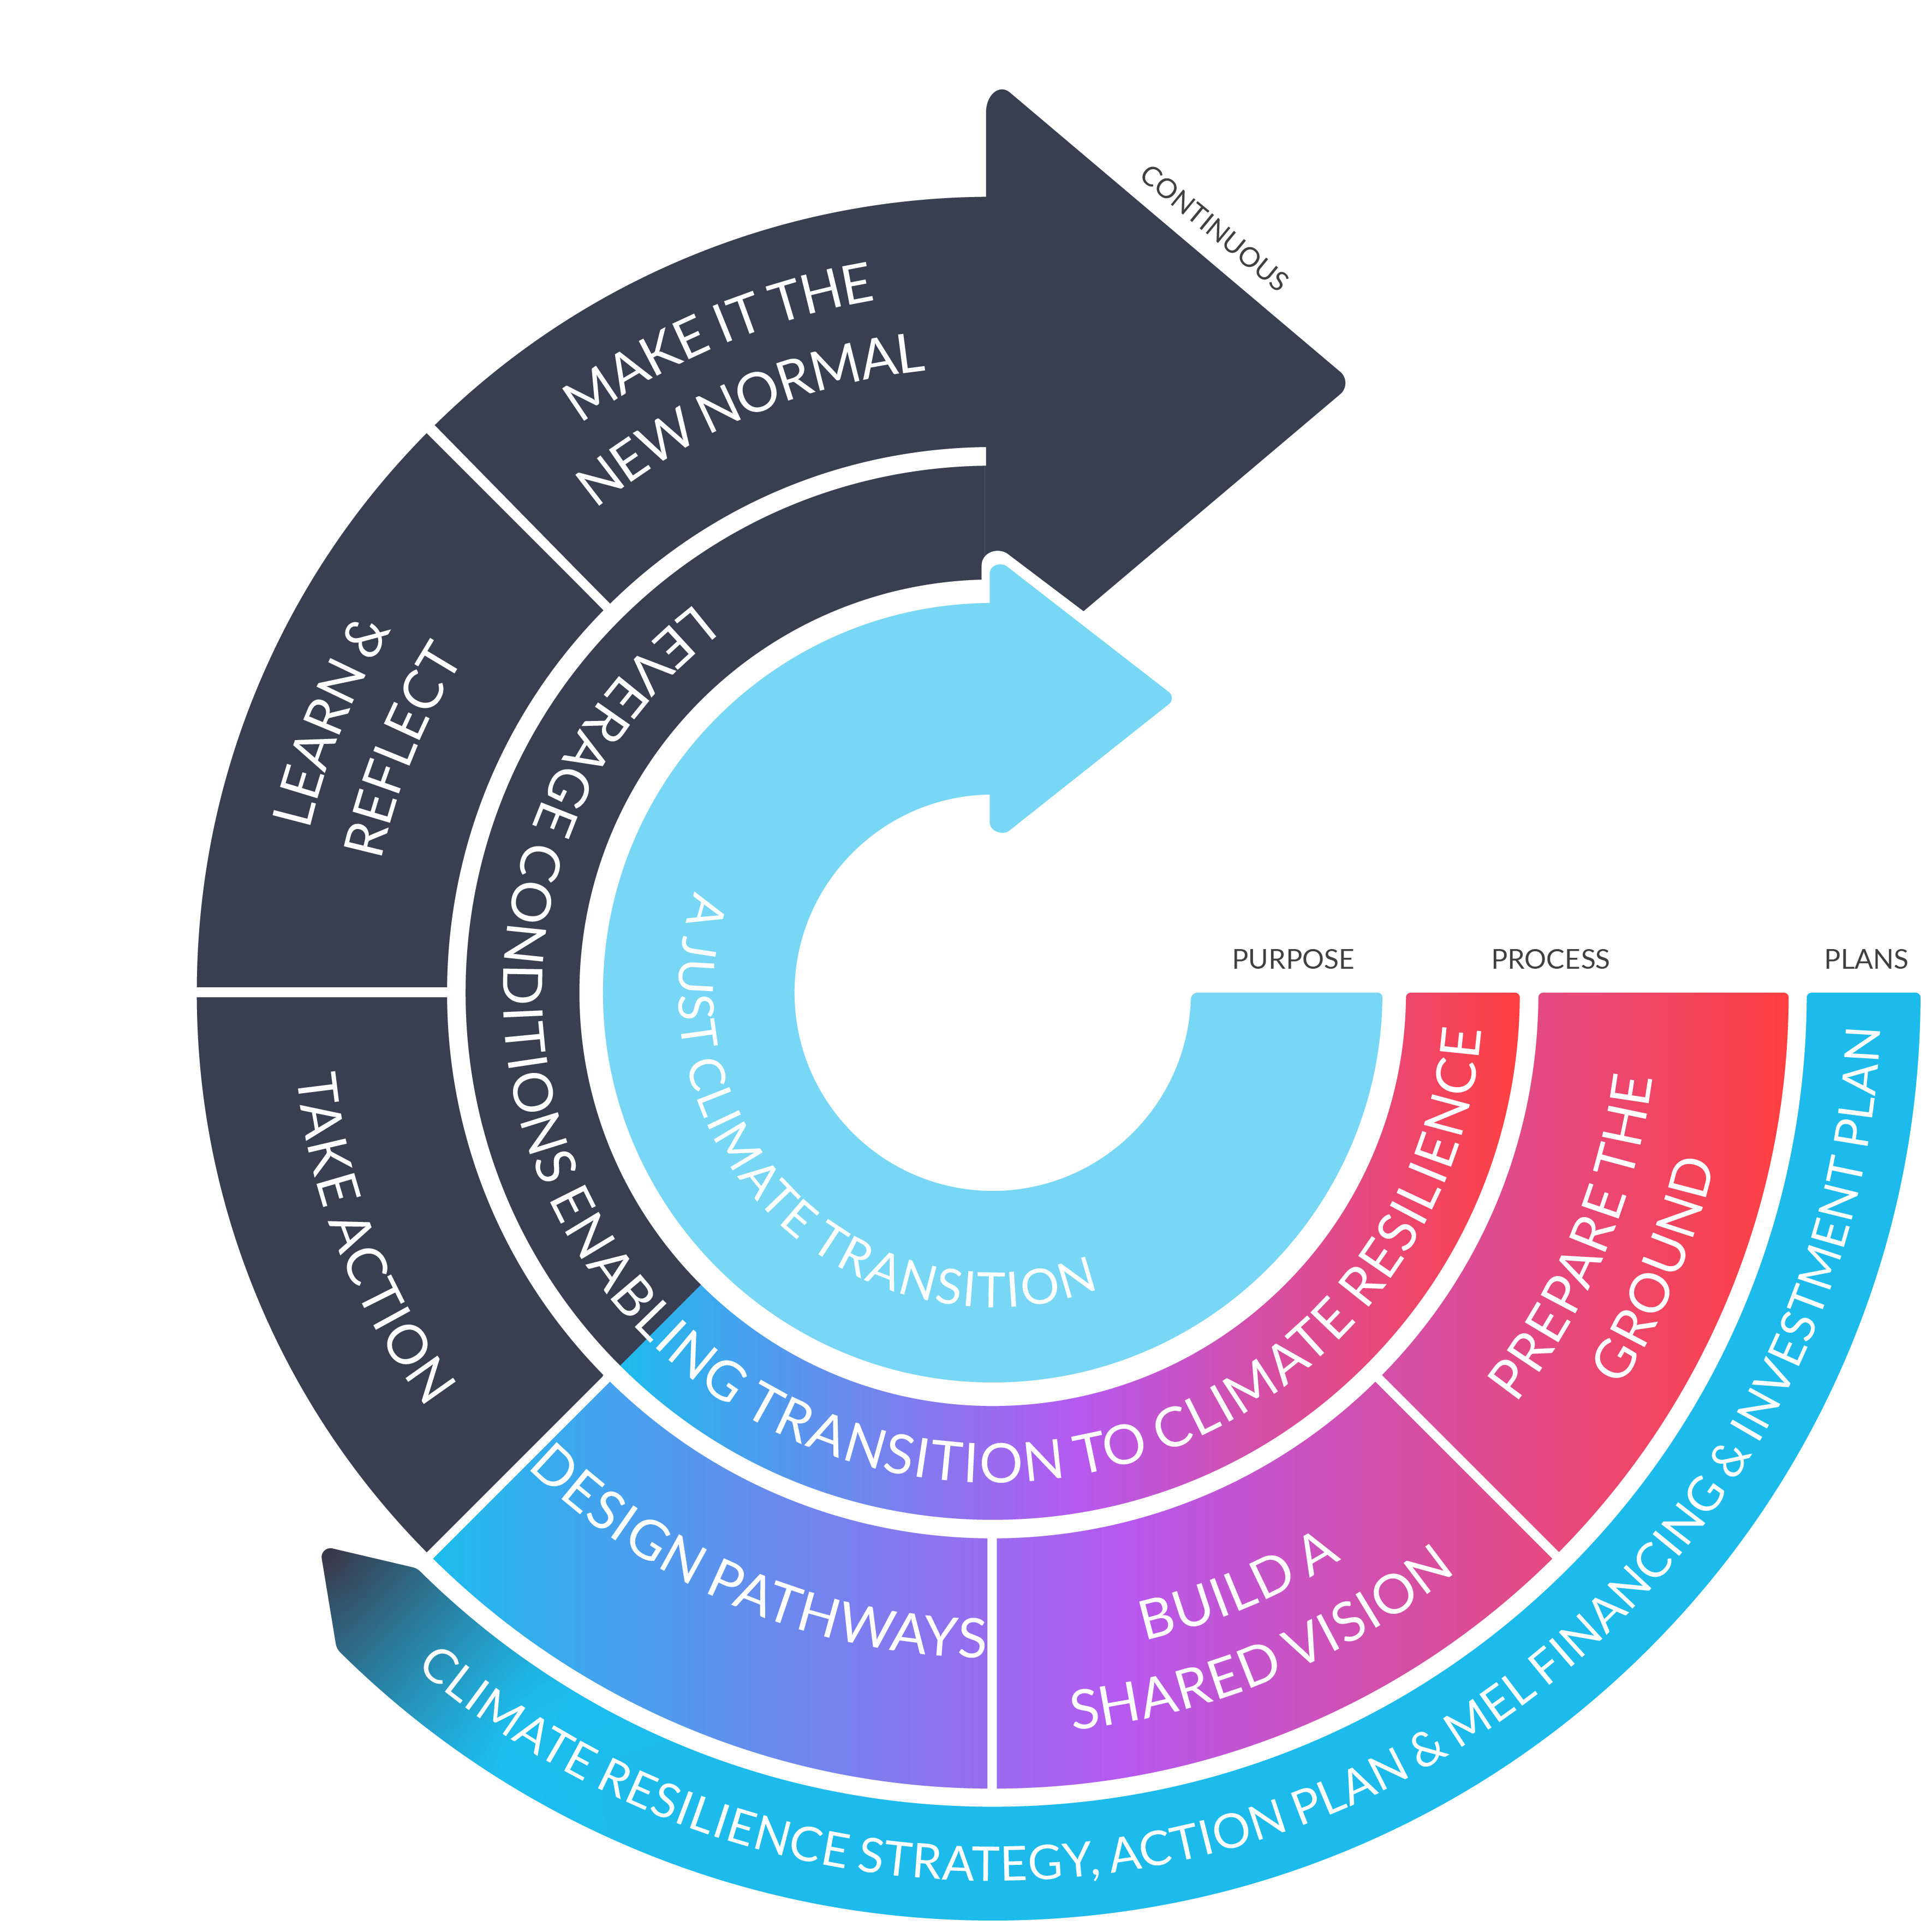
Regional Resilience Journey RRJ

Slide 5
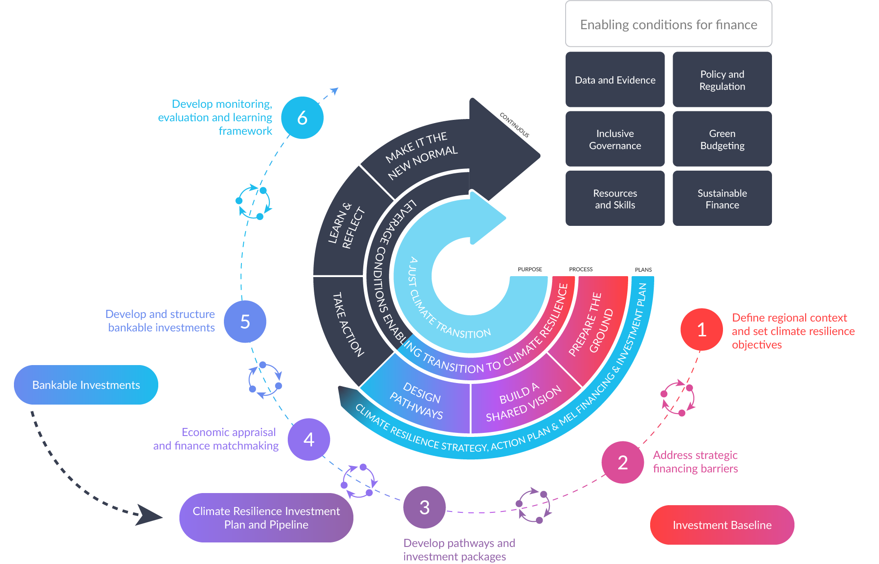
Adaptation Investment Cycle

Slide 6
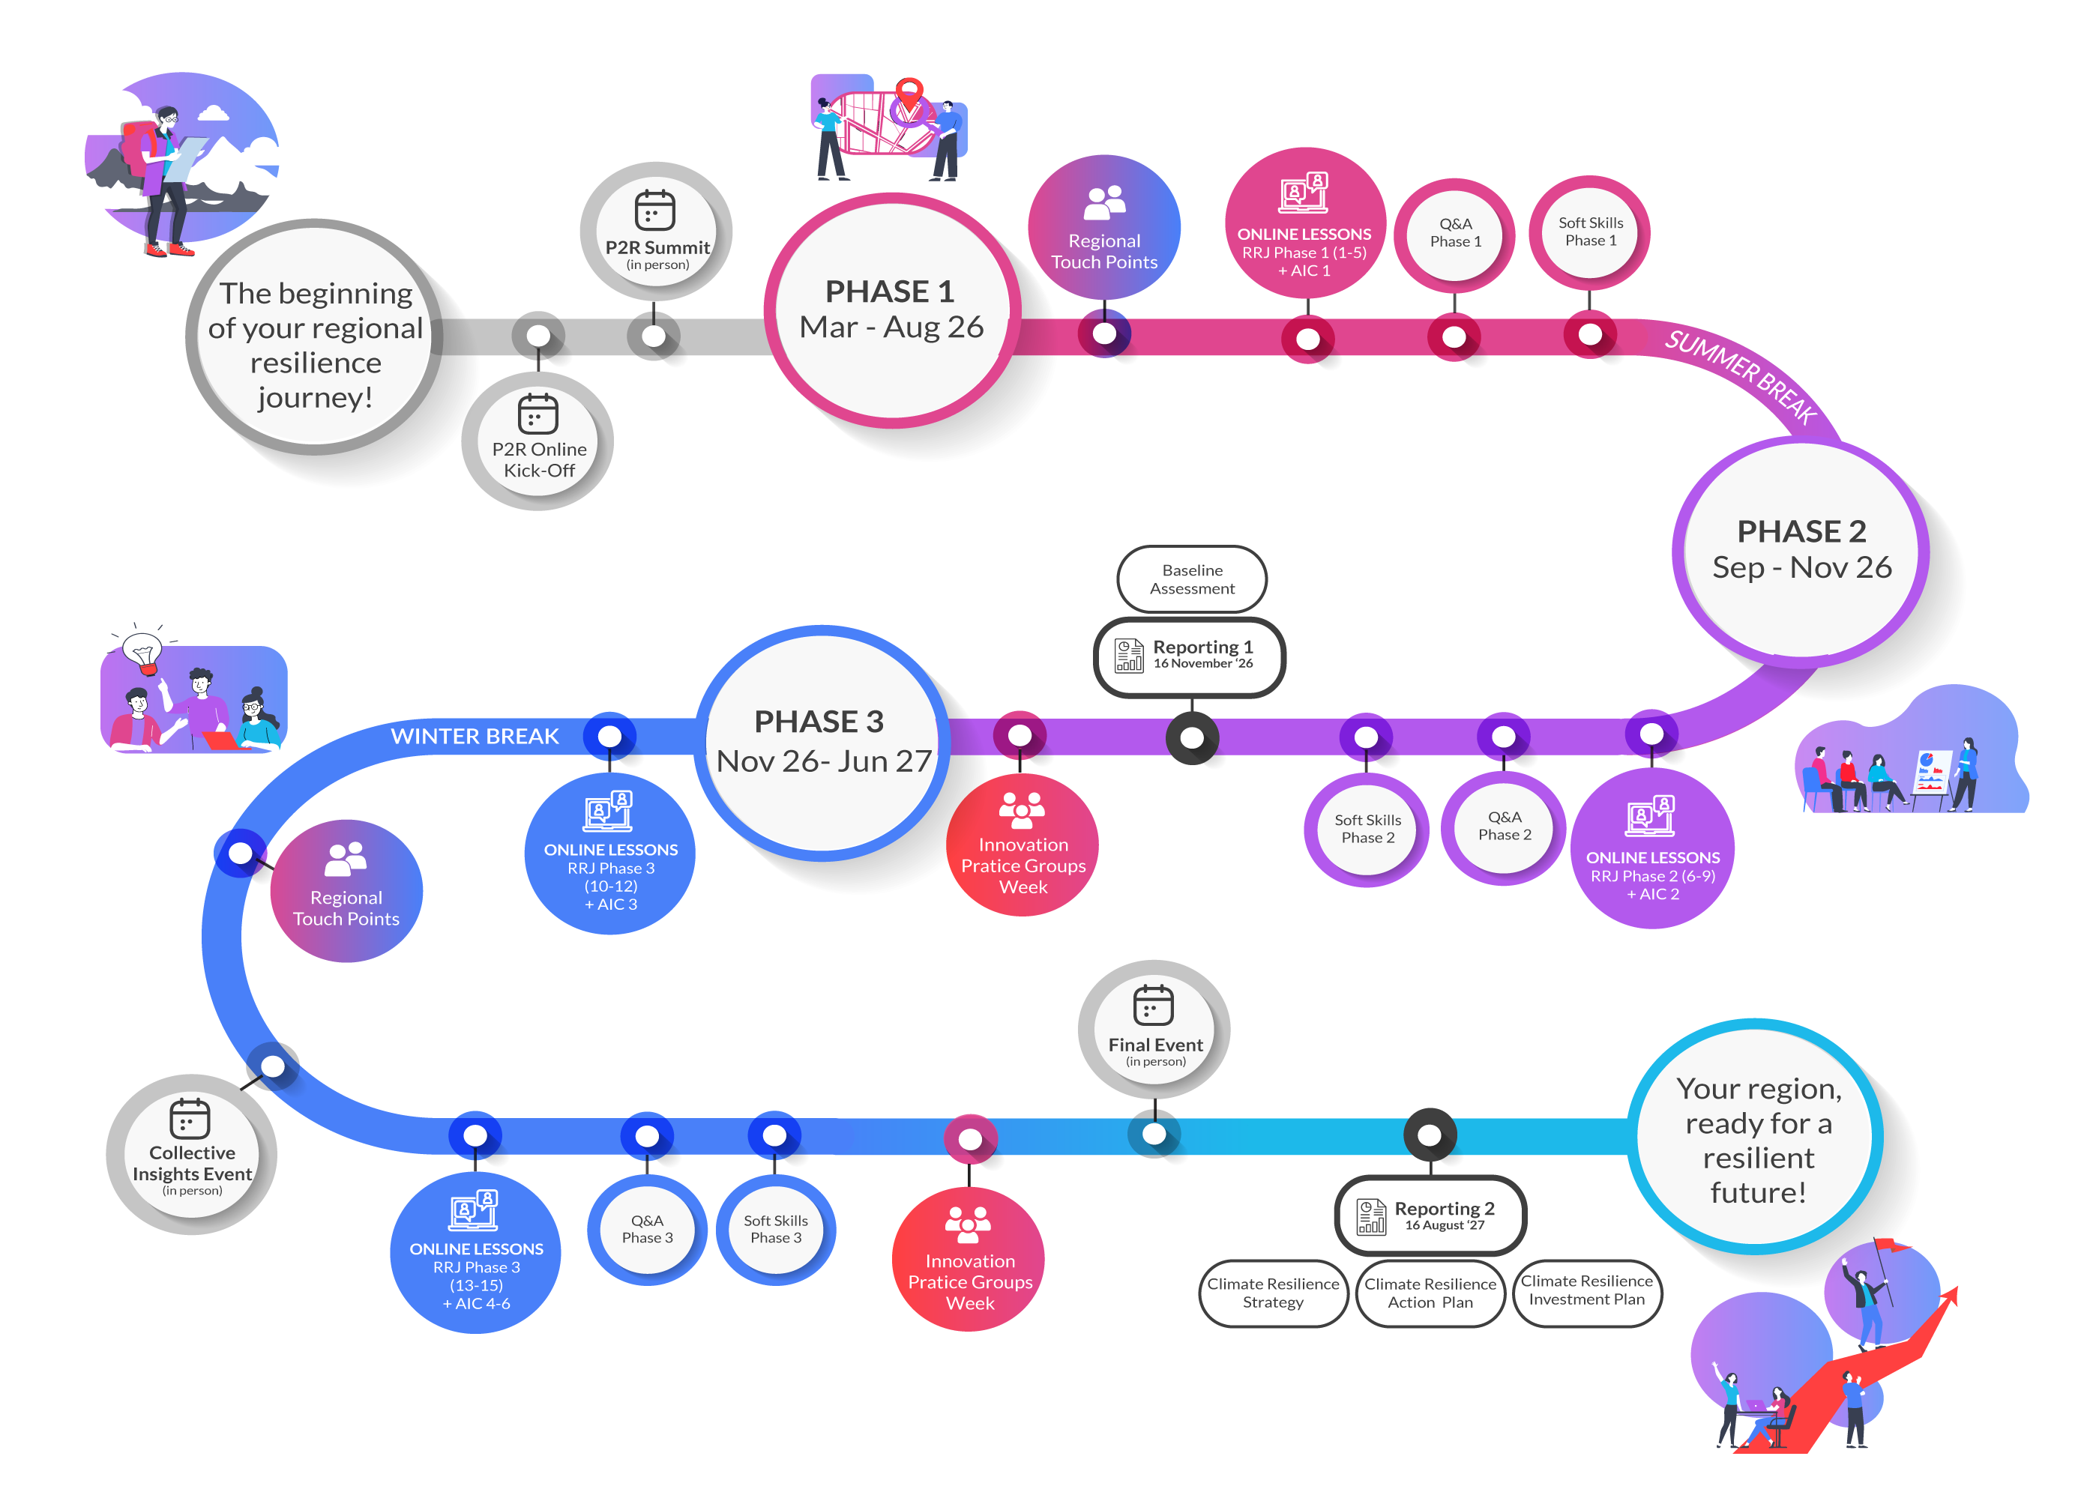
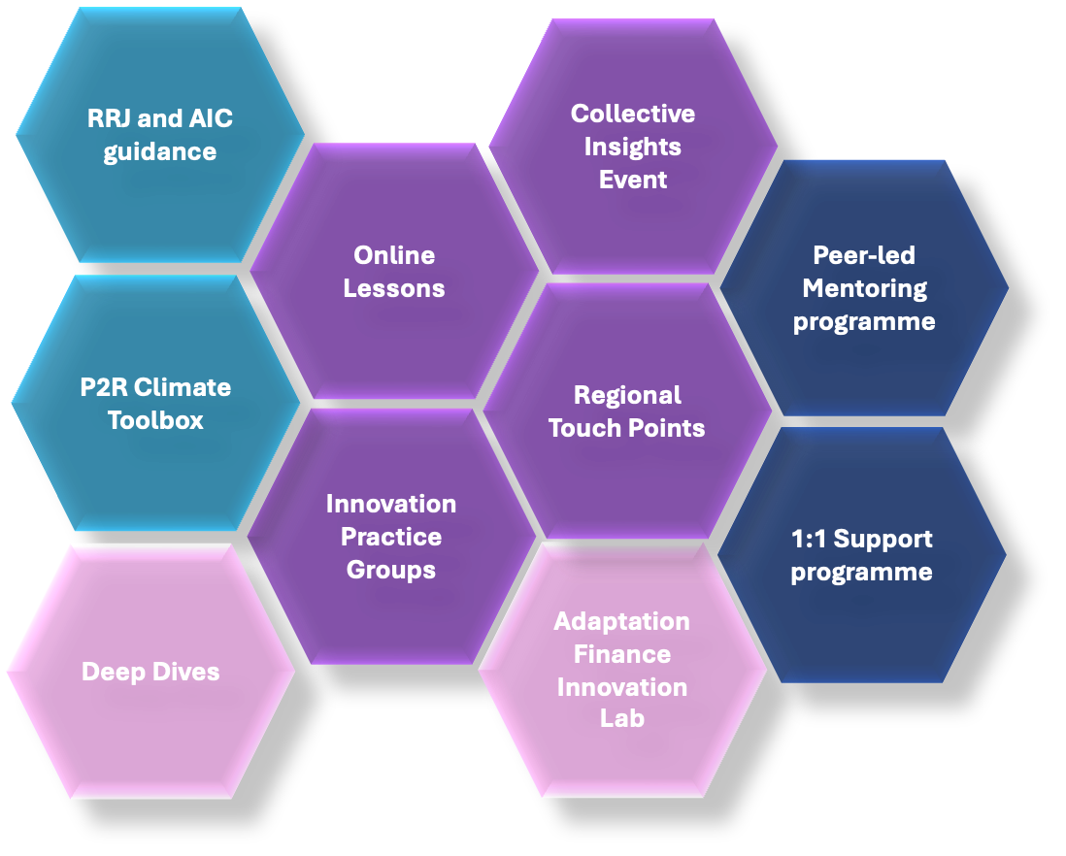
P2R Programme

Slide 7
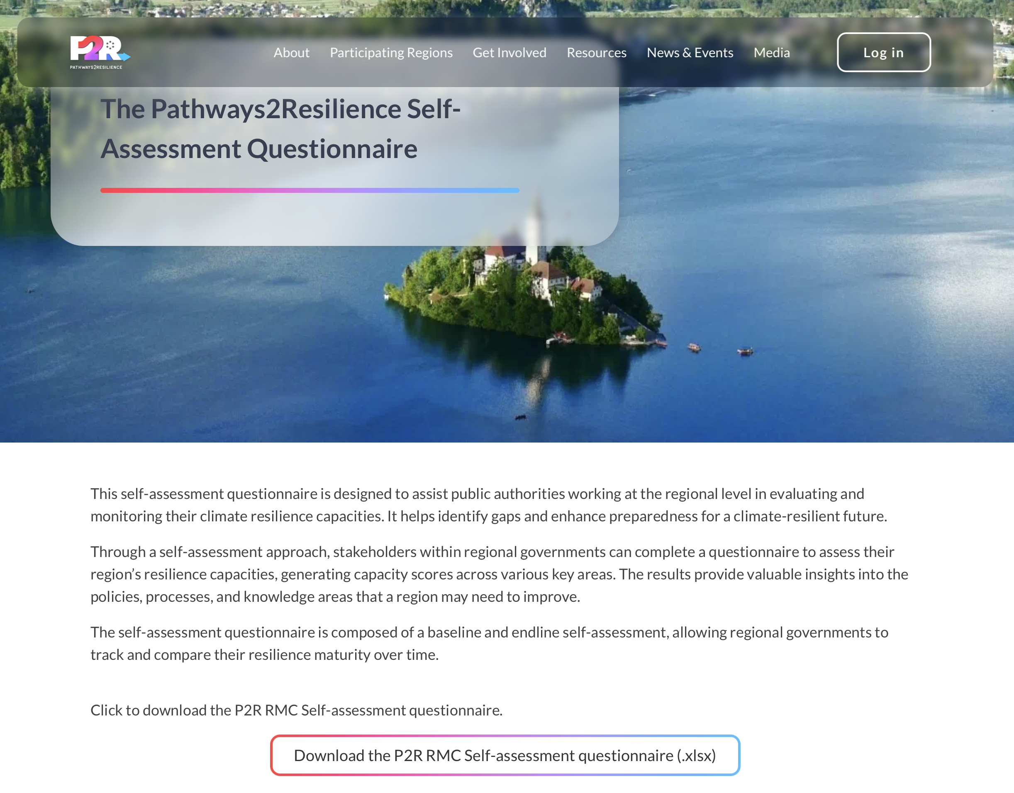
Resilience Capacities

Slide 8
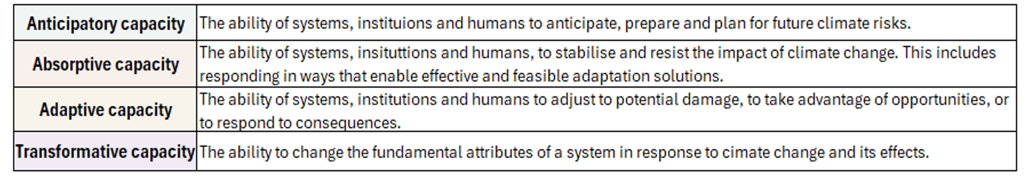
Resilience Capacities
The self-assesment recognises four core capacities that underpin resilience: anticipate future risks, absorb shocks, adapt to changing conditions, and transform systems for long-term climate resilience.
Strengthening resilience means building these capacities in a balanced, context-driven way, across interventions that address both urgent needs today and systemic readiness for the future.

Slide 9
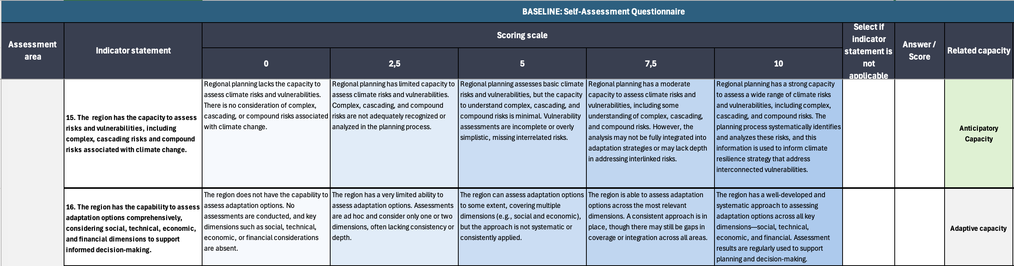
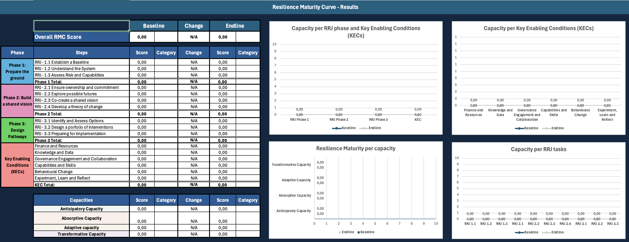
Resilience Capacities

Slide 10
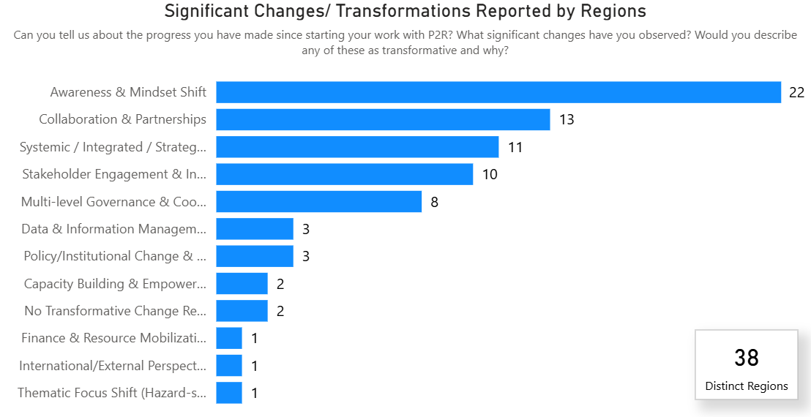
First results

Slide 11
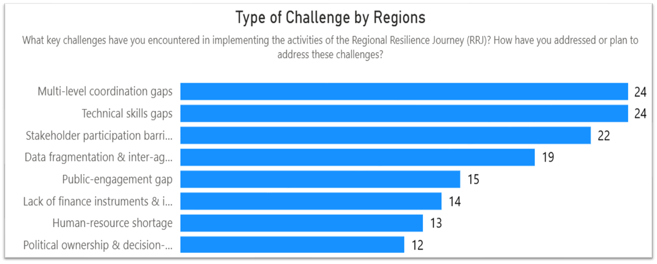
First results
Coordination complexity exceeds expectations
Institutional readiness often lags behind technical capacity
Knowledge gaps persist despite data availability

Slide 12
Thank you!
Welcome to the Pathways2Resilience community.

