Slide 1


TRANSCEND
3rd Webstival
Enabling Transformative Adaptation through Financial, Technical and Institutional Capacity Building
This project has received funding from the EU Horizon Europe Programme under GA 101084110 and from UK Research and Innovation's (UKRI) Horizon Europe Guarantee Scheme [award number 10044695]

Slide 2
Getting transformative adaptation projects ready for future funding opportunities?
Outline
Bankable adaptation projects – why they matter, what they are, and how to develop them: an introduction
EU Mission Adaptation to Climate Change and cascading funds – what opportunities are available for you
Examples of bankable ideas and what it takes to turn them into reality
Jaroslav Mysiak, Euro-Mediterranean Centre on Climate Change

Slide 3
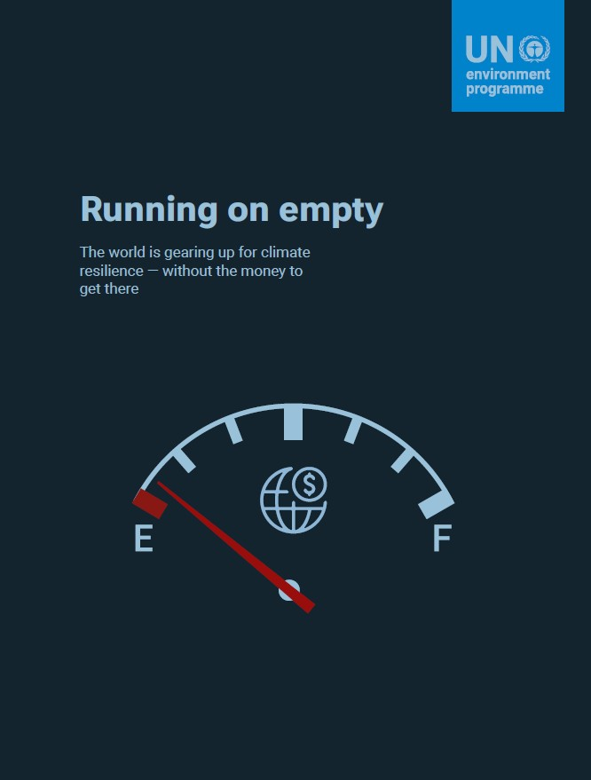
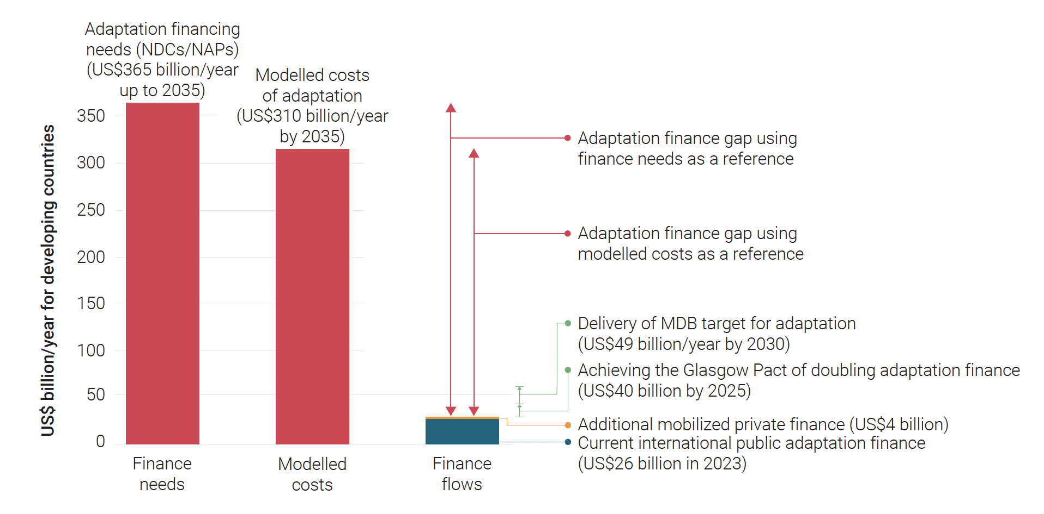
Why “Bankable” Matters?
Adaptation needs are now several times larger than available finance. Closing the gap requires a combination of international public finance, domestic investment, and scaled private participation.
Learn more: The UNEP Adaptation Gap Report is a science-based assessment of global progress on climate adaptation planning, financing, and implementation.
Notes:
Bankable adaptation refers to climate resilience projects designed with clear financial returns or risk-reduction metrics that make them attractive to private investors and lenders, rather than relying solely on public funding

Slide 4

What Is a Bankable Project?
Origins - from the Italian word banco or banca: a bench or table used by merchants to conduct transactions in marketplaces
A climate project becomes bankable when it combines sound preparation, credible finance structure, measurable impact, national ownership, and a clear fit with the priorities of the target funder (CDKN, 2017).
A project is bankable when its risk–return profile meets investor or funder criteria and it can secure financing for implementation. In simple terms, it is a project that financiers trust enough to support (CCFLA)
Learn more: Small cities guide 2023, GIZ 2029, ICLEI 2020
The Money Changer and His Wife, Quentin Matsys 1514, Louvre, Paris
Notes:
Bankable adaptation refers to climate resilience projects designed with clear financial returns or risk-reduction metrics that make them attractive to private investors and lenders, rather than relying solely on public funding

Slide 5
Adaptation investment pipelines
Global Center on Adaptation (GCA) Technical Assistance Program (TAP) is a project preparation facility designed to unlock adaptation finance by helping countries turn climate resilience priorities into investment-ready projects and programmes.
The InvestEU Advisory Hub is the European Union’s single entry point for advisory support and technical assistance to help develop investment projects across the EU. It is managed by the European Commission, with the European Investment Bank Group as the main delivery partner.
The C40 Cities Finance Facility (CFF) is a project preparation and advisory facility that helps cities in the Global South transform climate plans into funded infrastructure projects
Notes:
Bankable adaptation refers to climate resilience projects designed with clear financial returns or risk-reduction metrics that make them attractive to private investors and lenders, rather than relying solely on public funding

Slide 6
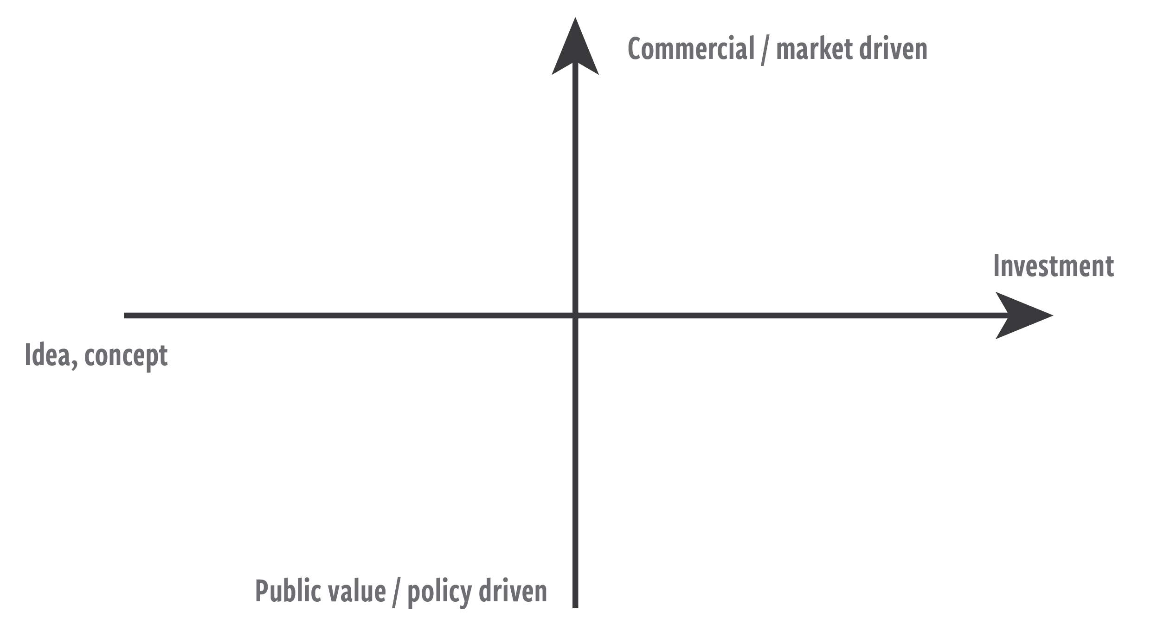
Business models
Revenue logic
PPP design
Aggregation
Roadshows
Lender engagement
Equity / debt access
Fundraising support
Feasibility studies
Climate risk analysis
Governance support
Capacity building
Guarantees
Blended finance
Insurance
First-loss capital
Notes:
Bankable adaptation refers to climate resilience projects designed with clear financial returns or risk-reduction metrics that make them attractive to private investors and lenders, rather than relying solely on public funding

Slide 7
Common barriers
Lack of investment-ready projects. Many adaptation ideas remain early-stage concepts and lack the technical, financial, or commercial maturity needed by investors.
Difficult to aggregate small projects. Adaptation investments are often local, fragmented, and small-scale, making it hard to bundle them into portfolios attractive to institutional finance.
Weak project pipelines. There is often no transparent, continuous pipeline of prepared projects that investors can assess and finance.
Public-good characteristics. Many adaptation benefits (flood protection, ecosystem resilience, water security) generate shared societal value rather than direct private revenues.
High due diligence and preparation costs. Complex risk assessments, feasibility studies, legal structuring, and transaction costs can make projects too expensive relative to ticket size.
Learn more: Climate Policy Initiative CPI barriers to bankability
Notes:
Bankable adaptation refers to climate resilience projects designed with clear financial returns or risk-reduction metrics that make them attractive to private investors and lenders, rather than relying solely on public funding

Slide 8
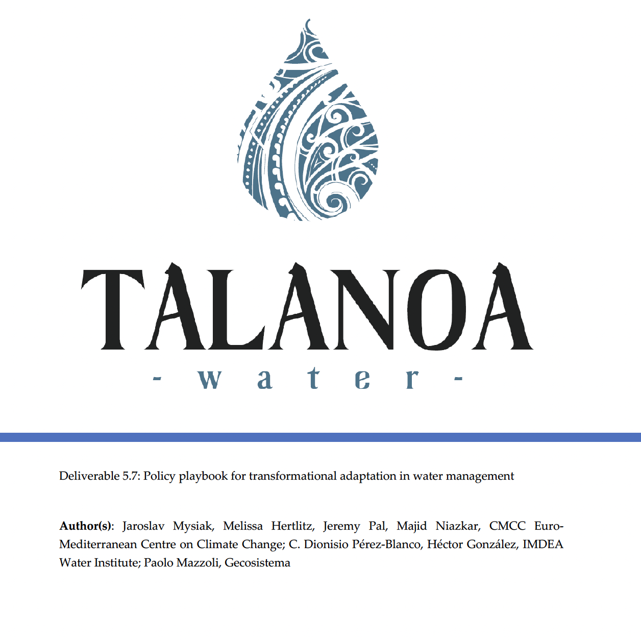
Skills & Capabilities Needed
Bankable adaptation projects require more than funding: they need capabilities to convert adaptation needs into investment-ready projects
This includes skills in project preparation, financial structuring, risk reduction, valuation of benefits, governance, stakeholder alignment, and measurable performance delivery.
Learn more: Policy playbook for transformational adaptation in water management 2025
Notes:
Bankable adaptation refers to climate resilience projects designed with clear financial returns or risk-reduction metrics that make them attractive to private investors and lenders, rather than relying solely on public funding

Slide 9
Mission adaptation
a flagship initiative dedicated to advancing interdisciplinary and cross-sectoral research and innovation,
national and subnational public authorities work side by side with research and innovation institutions to enhance Europe’s resilience to climate risks and shocks,
Objective 1: Prepare and Plan for Climate Resilience
Objective 2: Accelerate Transformations to Climate Resilience
Objective 3: Demonstrate Systemic Transformations to Climate Resilience
Notes:
Bankable adaptation refers to climate resilience projects designed with clear financial returns or risk-reduction metrics that make them attractive to private investors and lenders, rather than relying solely on public funding

Slide 10


Cascading Funds Management
Up to 300,000 EUR lump sum funding per project;
Access and bespoke support to the CRA toolbox;
Methodological guidance and support through the CLIMAAX helpdesk;
Technical advice and counseling to implement the locally tailored methodologies using local data and approaches;
Access to the outreach and engagement events organized by CLIMAAX
Single eligible public authorities or consortia led by an eligible coordinator, with SMEs/non-profits as partners.
Application had to target one NUTS/LAU region or community.
Funding up to €210,000, 100% reimbursed for planning, resilience strategies, action plans, and investment pathways.
Selection criteria: eligibility, vulnerability, resilience maturity, commitment, and strategic diversity.
Implementation: selected applicants received an 18-month support project.
Notes:
Bankable adaptation refers to climate resilience projects designed with clear financial returns or risk-reduction metrics that make them attractive to private investors and lenders, rather than relying solely on public funding

Slide 11
What we have learned so far
Attractive due to lighter procedures, smaller grants, and faster access than standard Horizon calls; oversubscription is common.
Well suited for pilots, demonstrations, SMEs, start-ups, cities, and local actors less able to access mainstream EU funds.
Clear rules, short applications, quick evaluations, and low administrative burden are critical for success.
Without active communication, stronger regions dominate; webinars, FAQs, and matchmaking improve diversity and quality.
Fast contracting and payments are valued, but local and regional authorities often struggle with procurement rules.
Strong on immediate outputs, but weaker evidence on long-term scaling, uptake, and systemic impact.
Many small grants need mentoring, portfolio management, clustering, and replication pathways.
Notes:
Bankable adaptation refers to climate resilience projects designed with clear financial returns or risk-reduction metrics that make them attractive to private investors and lenders, rather than relying solely on public funding

Slide 12
Adaptation Bankability Accelerator
HORIZON-MISS-2026-01-CLIMA-07: Supporting financing of local adaptation actions with combination of public funding and private financing
Grants with private bank loans for adaptation investments.
Cascade funding Up to €800,000 per third party
Local actions €500k–€10m; grants max 70% of costs.
Public bodies, private entities, SMEs, local/regional authorities.
Innovative adaptation projects, especially NbS
Demonstrations, lessons learned, finance models
Strong cooperation with EIB
Timeline
Applications for management of the accelerator closes in Septembr 2026.
Choice of the consortium by January 2027, Grant agreement signed by June 2027.
Call for cascading funds to be published by Spring 2028, deadlines with 2-3 months.
If you are interested and eligible, you have 2 years to get ready for the appliucation to get up to 800k Euro
Notes:
Bankable adaptation refers to climate resilience projects designed with clear financial returns or risk-reduction metrics that make them attractive to private investors and lenders, rather than relying solely on public funding

Slide 13
Water allocation reform
is not only governance reform - it can be framed as an investment programme combining digitalisation, efficiency gains, avoided losses, and long-term water security.
Scope: Modernise water rights or permits, Introduce Dynamic drought allocation rules, Design transparent exchange or reallocation platform, Protect environmental flows.
What could be invested: smart metering systems, water accounting platform, climate related secrives, market exchange platform, compliance monitoring, stakeholder transition support
Notes:
Bankable adaptation refers to climate resilience projects designed with clear financial returns or risk-reduction metrics that make them attractive to private investors and lenders, rather than relying solely on public funding

Slide 14
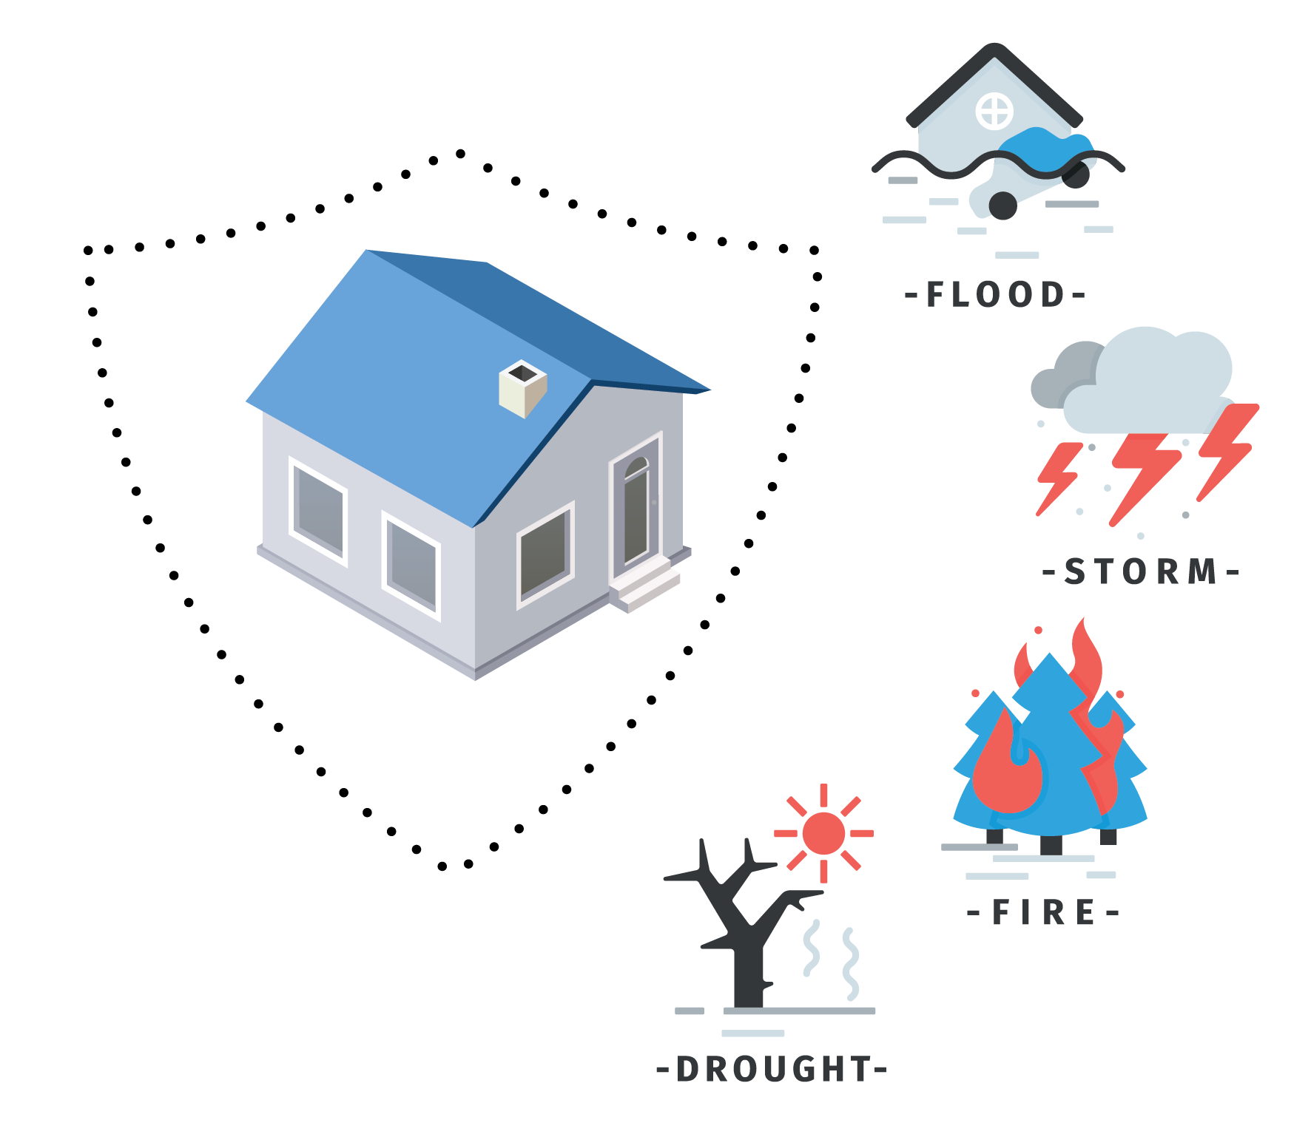
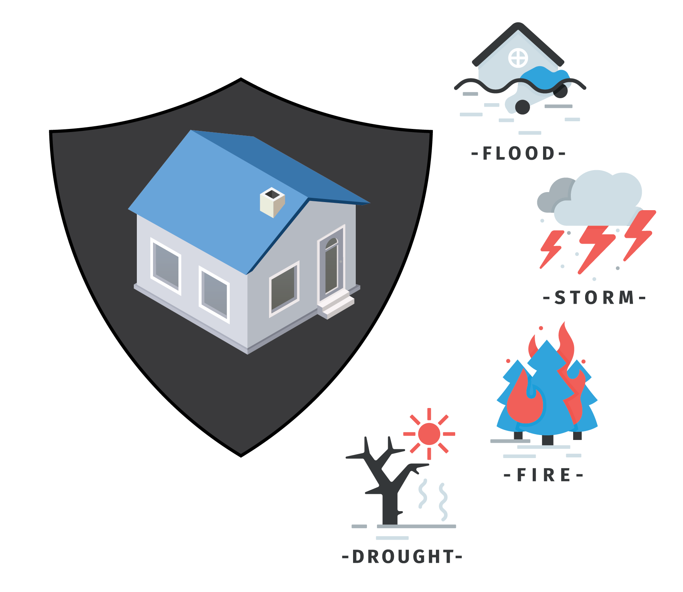
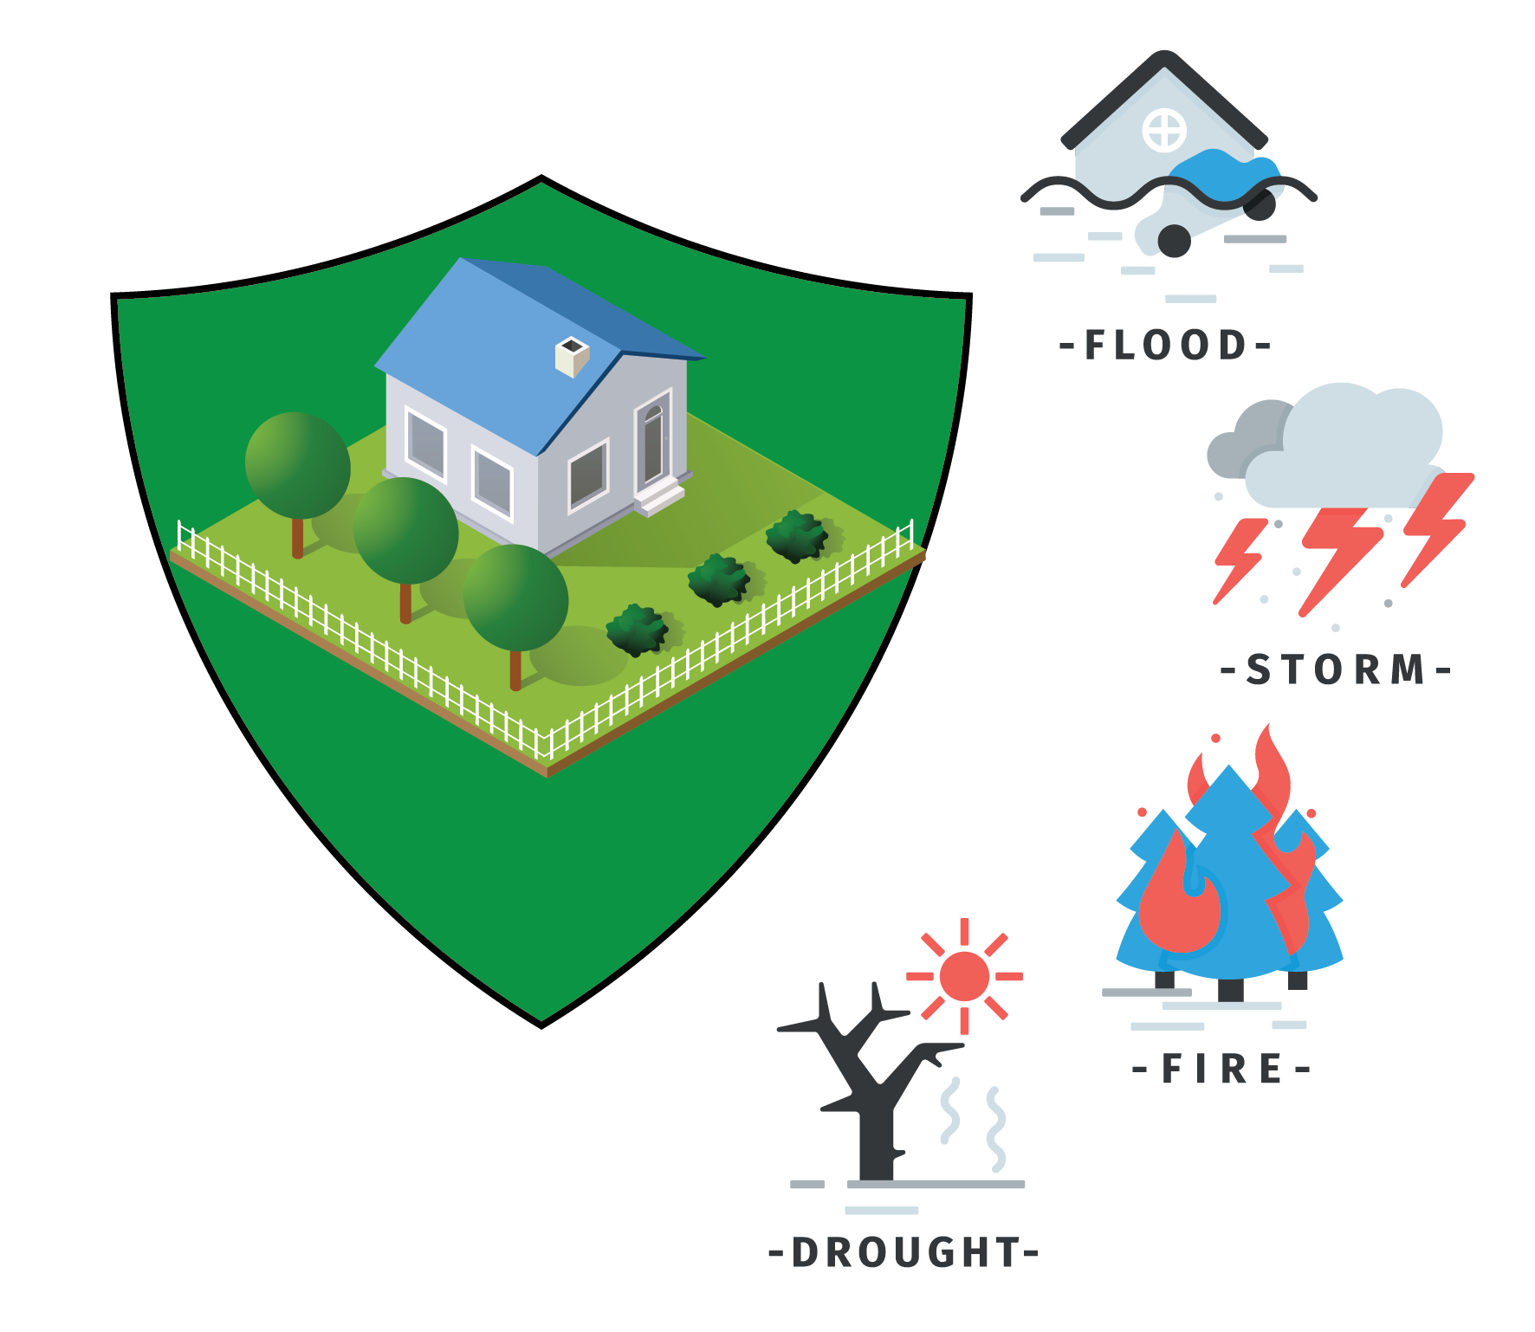
Nature-based insurance solutions
Notes:
Bankable adaptation refers to climate resilience projects designed with clear financial returns or risk-reduction metrics that make them attractive to private investors and lenders, rather than relying solely on public funding

Slide 15
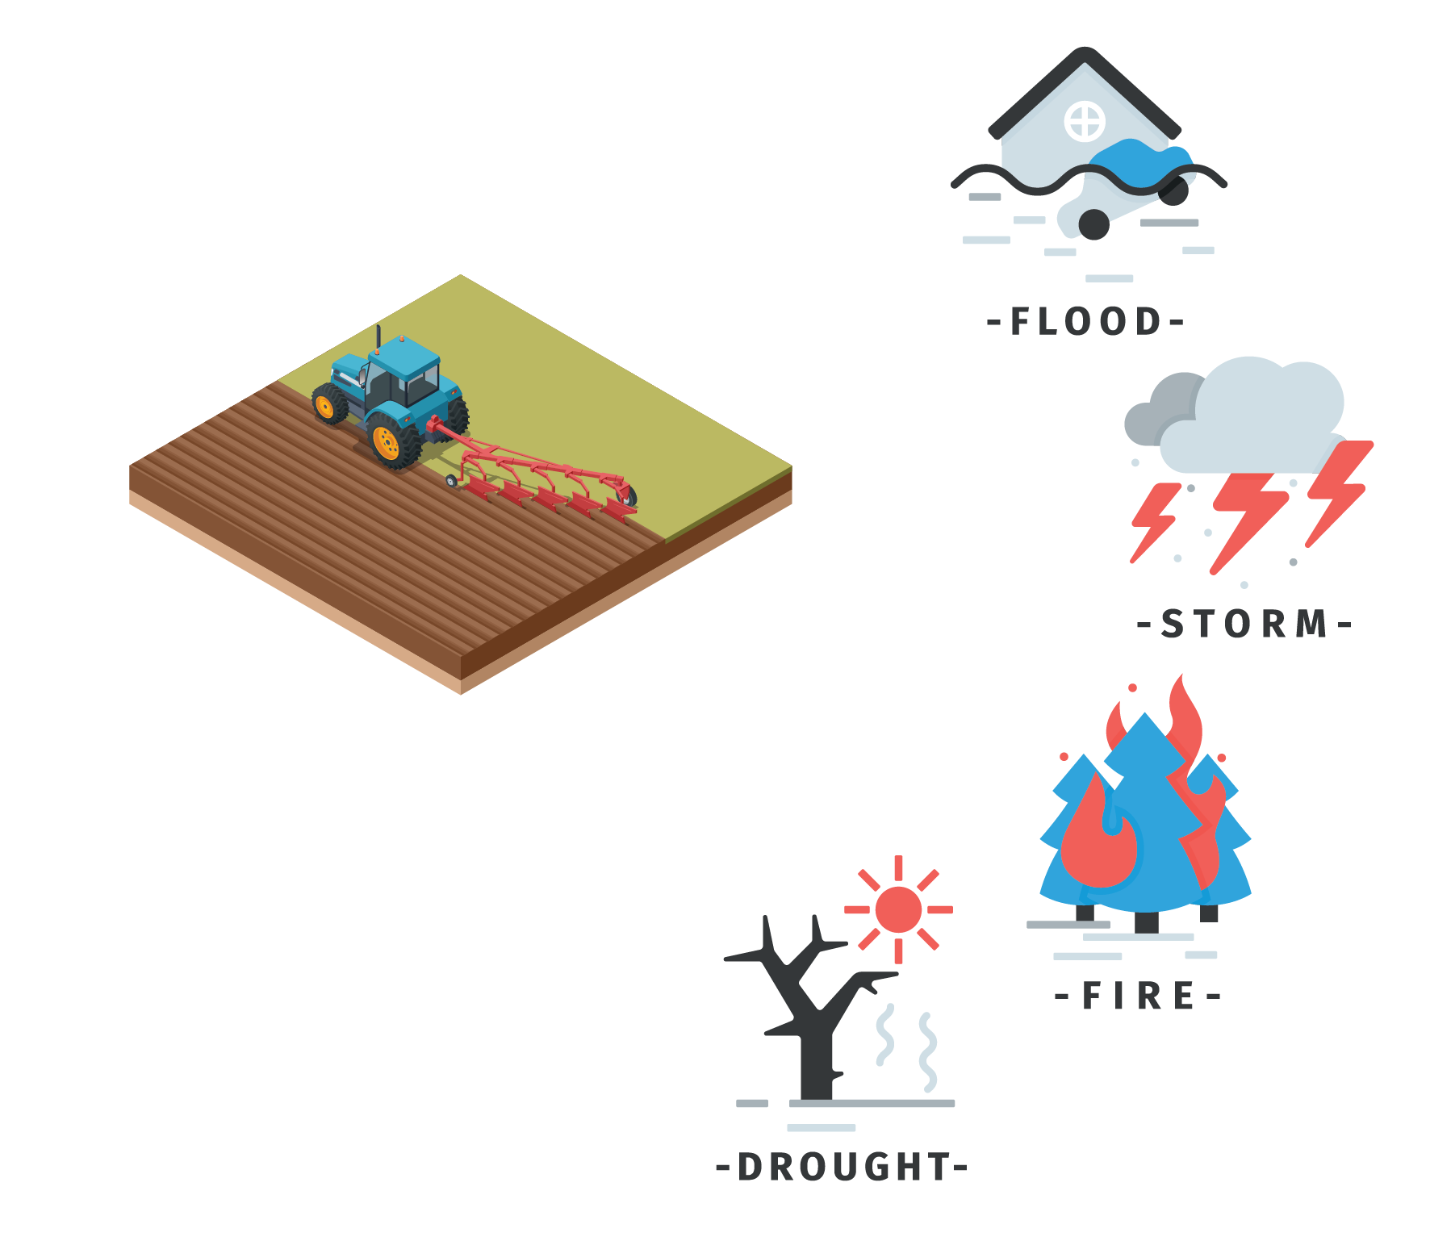
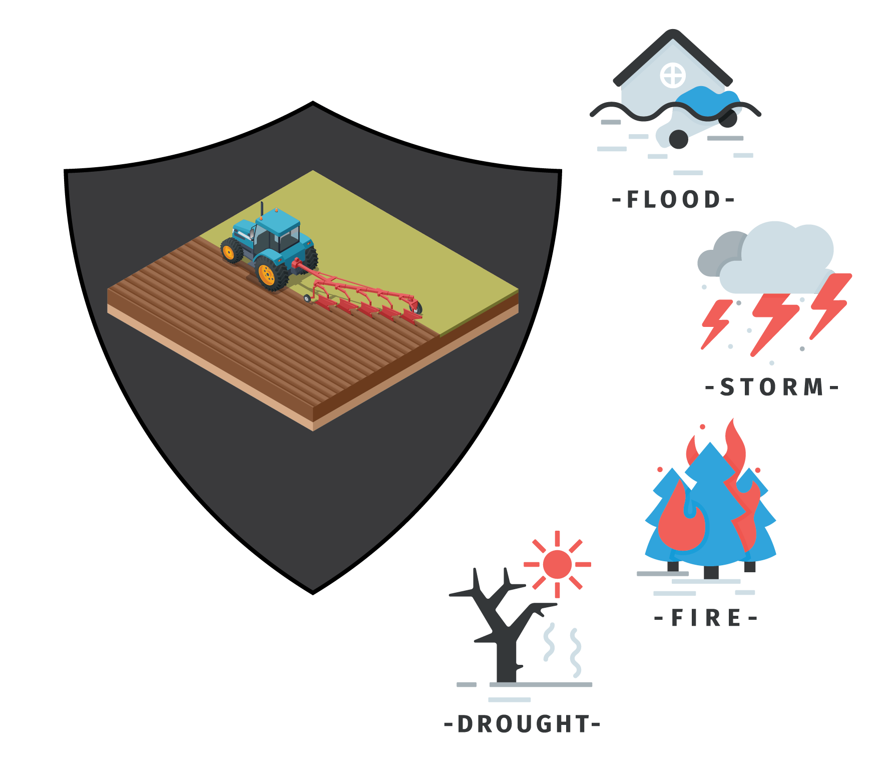
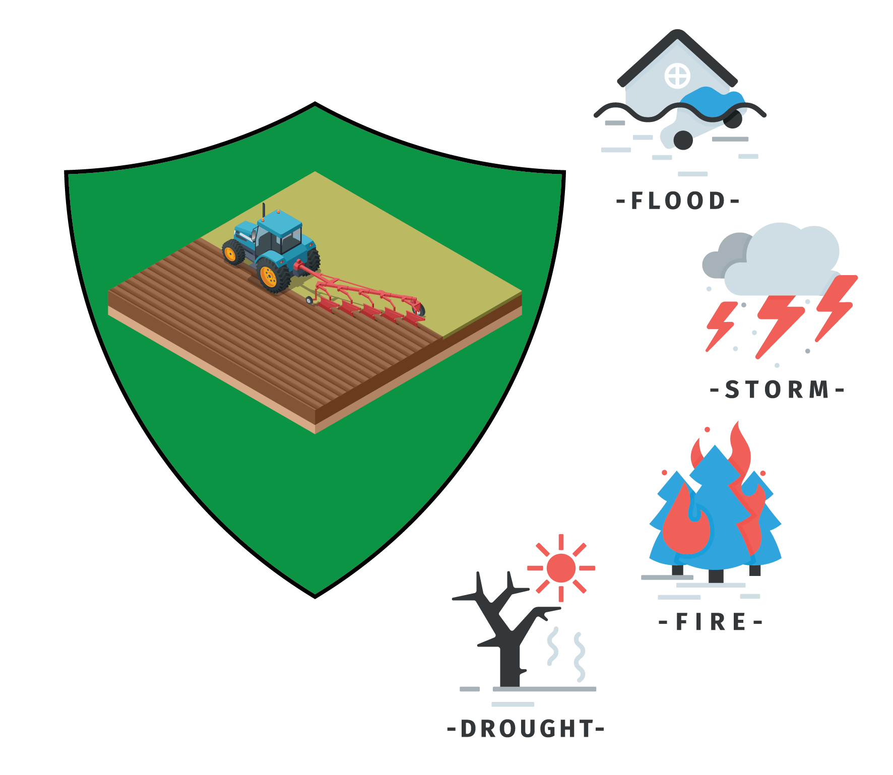
Nature-based insurance solutions
Unprotected agricultural property values theoretically reflect climate risks, but hazard classification maps may not accurately capture the true risk level.
Insurance protects yield or income from climate-related damage but offers little incentive to reduce risk beyond contract terms; coverage may be lost if it becomes unsustainable.
Insurance promotes risk reduction through contracts and innovative schemes, fostering confidence in continued coverage as climate-related damage rises.
Notes:
Bankable adaptation refers to climate resilience projects designed with clear financial returns or risk-reduction metrics that make them attractive to private investors and lenders, rather than relying solely on public funding

Slide 16
Nature-based insurance solutions
Rural areas and low-value land uses can serve as natural buffers, protecting urban centers and high-value properties from climate-related hazards such as flooding. Wetlands, forests, and agricultural lands can absorb excess water, reduce runoff, and enhance resilience. Strategic land-use planning that preserves and restores these areas not only safeguards urban infrastructure but also supports biodiversity and sustainable water and land management.
Notes:
Bankable adaptation refers to climate resilience projects designed with clear financial returns or risk-reduction metrics that make them attractive to private investors and lenders, rather than relying solely on public funding

Slide 17


Follow us!
@transcend_research_project
@transcend_horizon
@TRANSCEND-zs4rl
https://transcendresearchproject.com/

Slide 18














